Slide 1
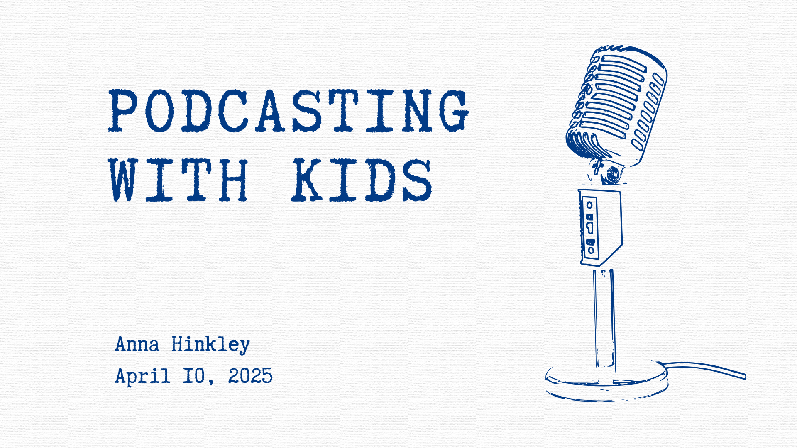

Slide 3
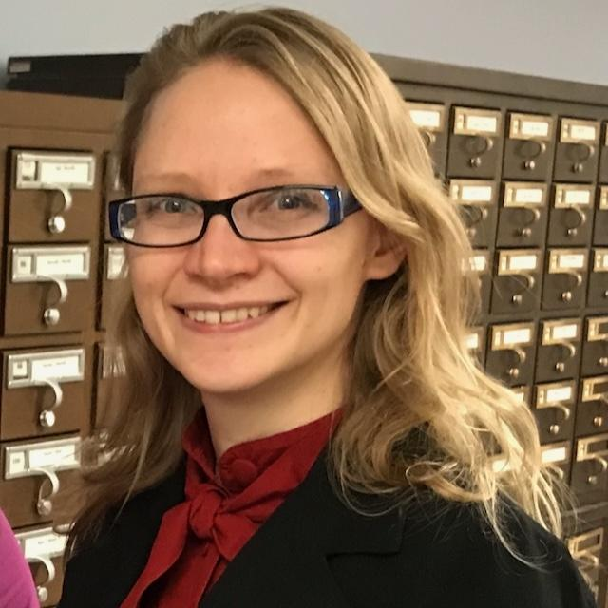
About me!
I am the Youth Services Librarian at Saline District Library
I first used recording technology in 7th grade
Background is in music, radio, and history
My podcasting programs are usually for ages 8-12

Slide 5
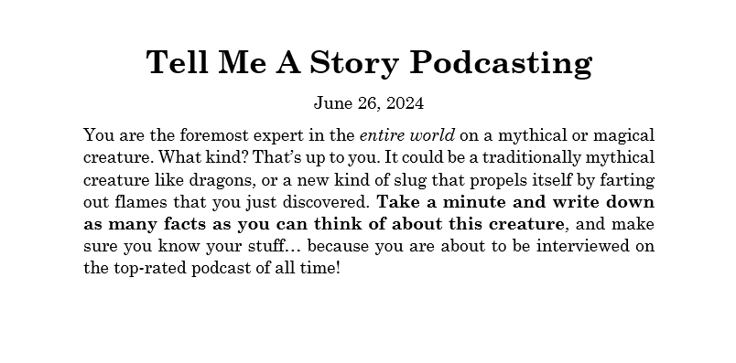
First, an example.
We are about to hear a short clip from a podcast created by two young podcasters.
I controlled the recording and editing, but the rest was all a response to this prompt.

Slide 6
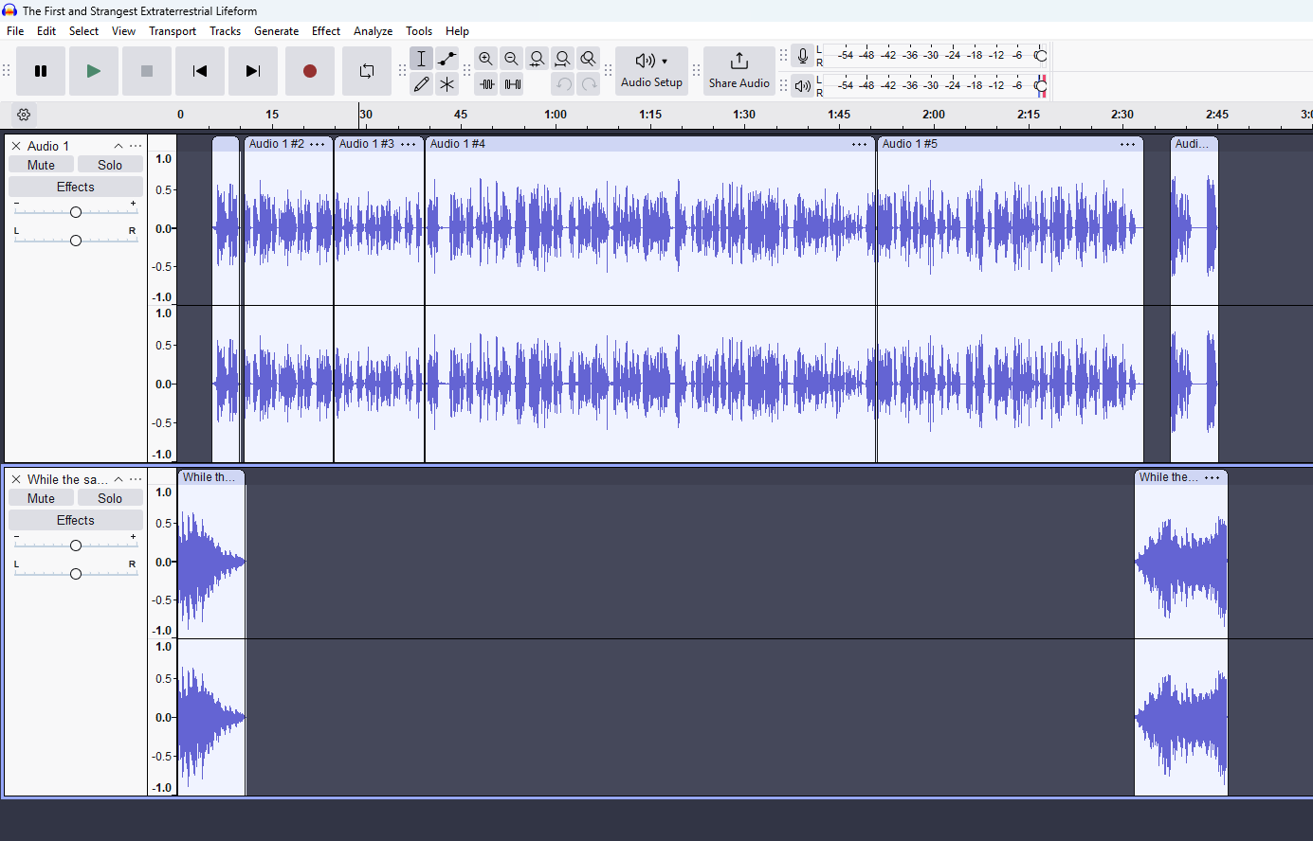

Slide 7
The First And Strangest Extraterrestrial Lifeform
Our podcasters:
Created an imaginary creature
Wrote an outline or a script
Came up with interview questions for each other
Recorded an interview
Choose music from a short list of available tunes for intro and outro music

Slide 8
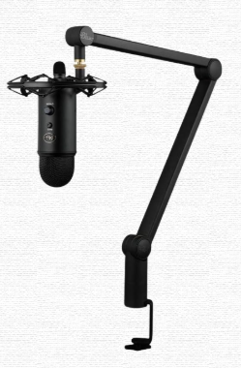
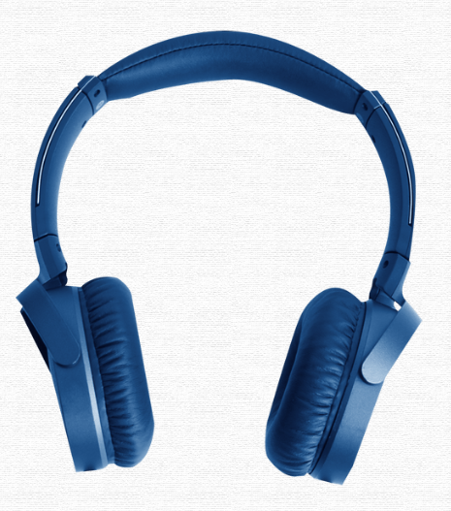
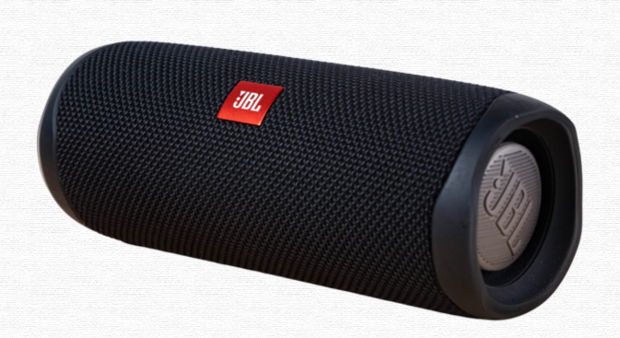
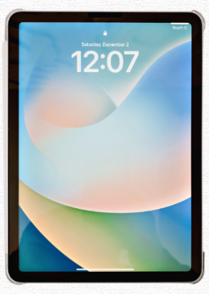
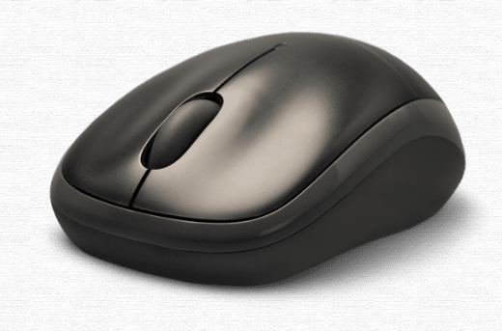
What tech equipment do you need?
Notes:
Optional: Projector so everyone can see themselves being recorded.

Slide 9
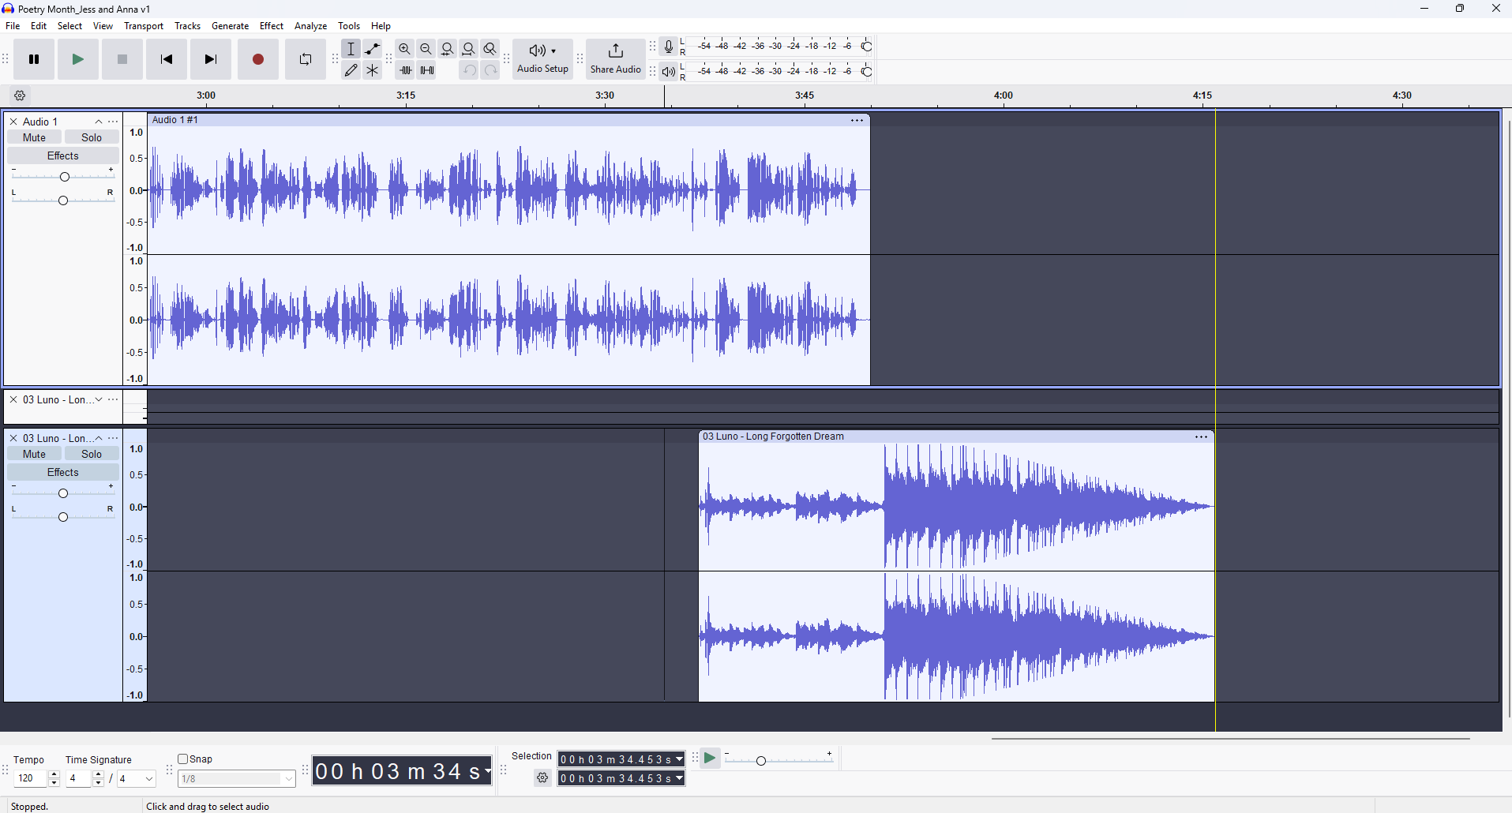
What kind of computer program do you need?
Notes:
Optional: Projector so everyone can see themselves being recorded.

Slide 10
Why Audacity?
Free
Available for Mac, PC, and Linux
Open source for more than a decade
Does not automatically publish to the web

Slide 11
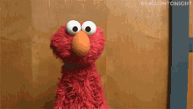
What kind of program space do you need?
Ideally, a sound booth
Since most of us don’t have that, a quiet room
But! Don’t be afraid to use other spaces around the library

Slide 12
What supplies do you need?
All of your tech set up and tested
A way to plan a recording
Scratch paper or butcher paper
White board
Outline worksheet
Inspiration or research materials
Something for kids to do while someone else records
Sound effect items
Everything makes a sound

Slide 13
Quick sidebar…
What’s the goal of a podcasting program?
What can you actually do in 1-2 hours?
In what ways are kids willing to participate in a podcasting program?

Slide 14
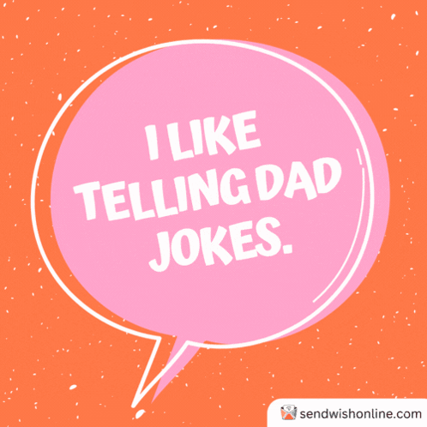
So where do you start?
What do a group of whales listen to on a long journey?
A POD-cast!

Slide 15
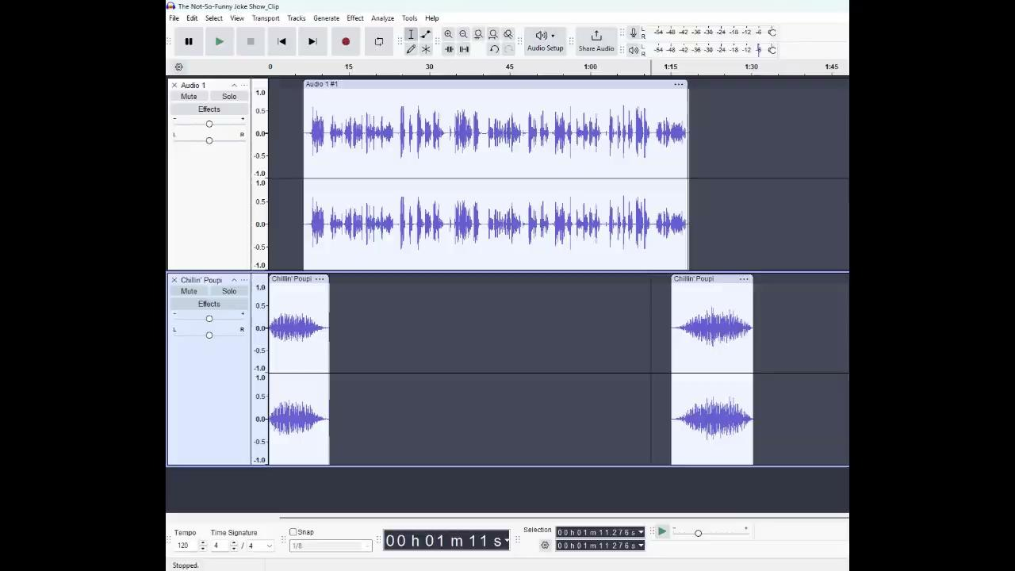

Slide 16
A Mostly Foolproof Plan for a Joke Show Podcast
10 minutes: Introduce the idea of a podcast, and play an example
20 minutes: Time to outline, plan, research, and practice
20 minutes: Record and play back
10 minutes: choose intro and outro music
After the program: Edit, export as MP3/MP4, and email to participants

Slide 17
Other Programs
Mythical Creature Expert
Sound Effects
Interviews
Fairy Tale Retelling
Prewritten Script
Write a Script
Sound Effects Storytelling
Editing

Slide 18
Basic Structure
Introduce podcasting
Play a related example
Have podcasters create a structure for their podcast
Provide materials for research and practice
Record
Send extra podcasters out with iPad
Play back recording
Play a selection of sound effects or music to be added in editing

Slide 19
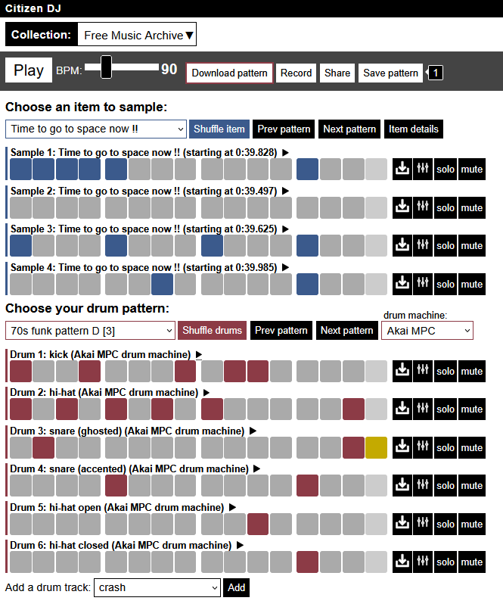
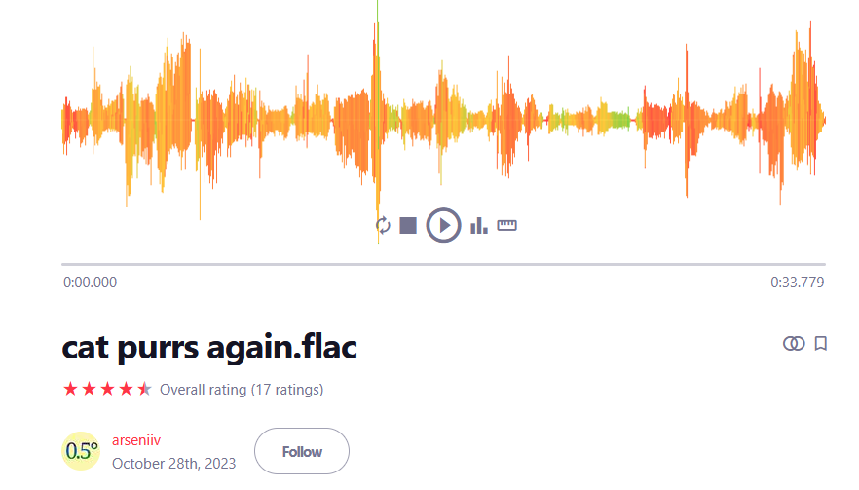
Music & Sounds
Library of Congress
Some editing softwares
Free Music Archive
Freesound

Slide 20
Sound Effects You Can Create
Hoofbeats
Shoes on floor
Typing Sounds
Clothes swishing
Paper of all kinds
Violin bow against metal
Wings

Slide 21
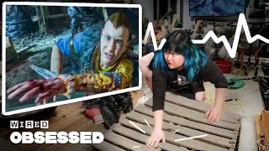

Slide 22
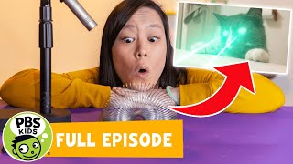

Slide 23
Other Tips & Tricks
Be prepared to complete editing after the program
Always save your original recording
Pick one focus for any particular program
Don’t put off editing after the program

Slide 24
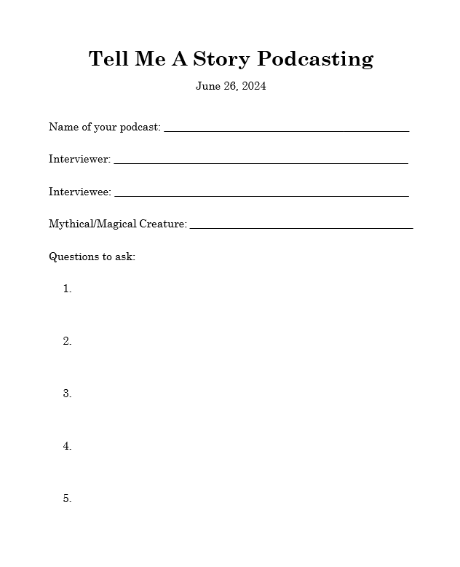
Helpful Handouts, etc.
NPR Teaching Guide
For programmers who have more time with podcasters
https://www.npr.org/2018/11/15/662116901/teaching-podcasting-a-curriculum-guide-for-educators

Slide 25
