Slide 1












BUILDING TEEN RESILIENCE
Using Trauma-Informed Practices to Boost Teen Services

Slide 2

HELLO, WELCOME TO OUR AGREEMENTS PAGE
PAGE 02
  Respect for each other and for privacy
  Be fully present, but if you need to step out, please feel free to do so
  Keep each other’s confidences (“what happens at SI...”)
  Be open to other perspectives and experiences
  Anything else?

Slide 3


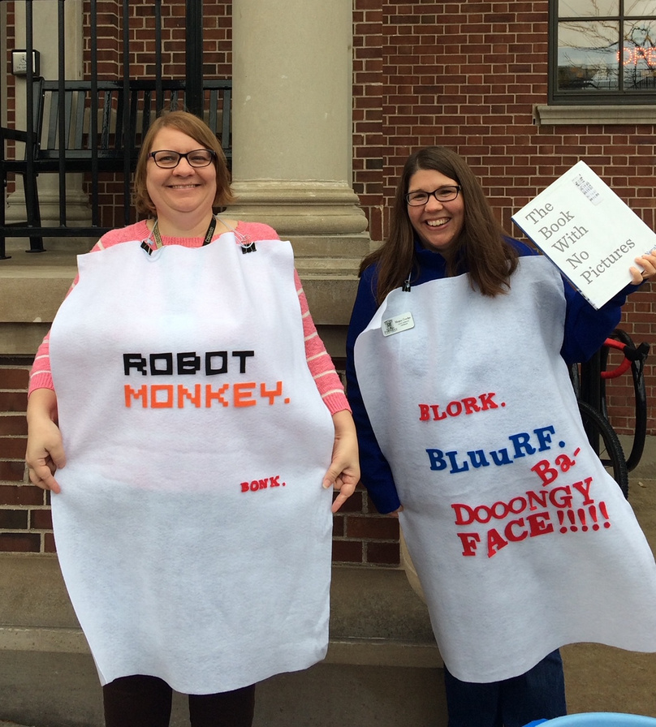

PAGE 04
ABOUT US
  Megan Goedge: Children’s Librarian at the Petoskey District Library since 2016 and a children’s librarian since 2005. Loves picture books with twist endings, baby smiles, and Below Deck.
  Nisa Kesseler: Teen services librarian at the Petoskey District Library. I have worked with teens my entire professional life, first as a teacher, then moved to the library in 2015. Loves books, Star Trek, and games!
Megan & Nisa

Slide 4
WHAT WE WILL COVER
Typical child development
What is Trauma?
What is Resilience?
Adverse Childhood Experiences
Applying Trauma-Informed Practices

Slide 5
Child Development Overview
Tween/Teen
Middle Childhood
Early Childhood
10-18
6-9
0-5
Onset of puberty means lots of physical growth. Uneven brain development means that good judgment is often overruled by impulsive behaviors.
Learning independence, but still crave routine!
Development of self and experiences.
Praise this age for making their own choices and decisions.
Those synapses are firing! Crawling, standing, babbling, developming fine and gross motor skills.

Slide 6

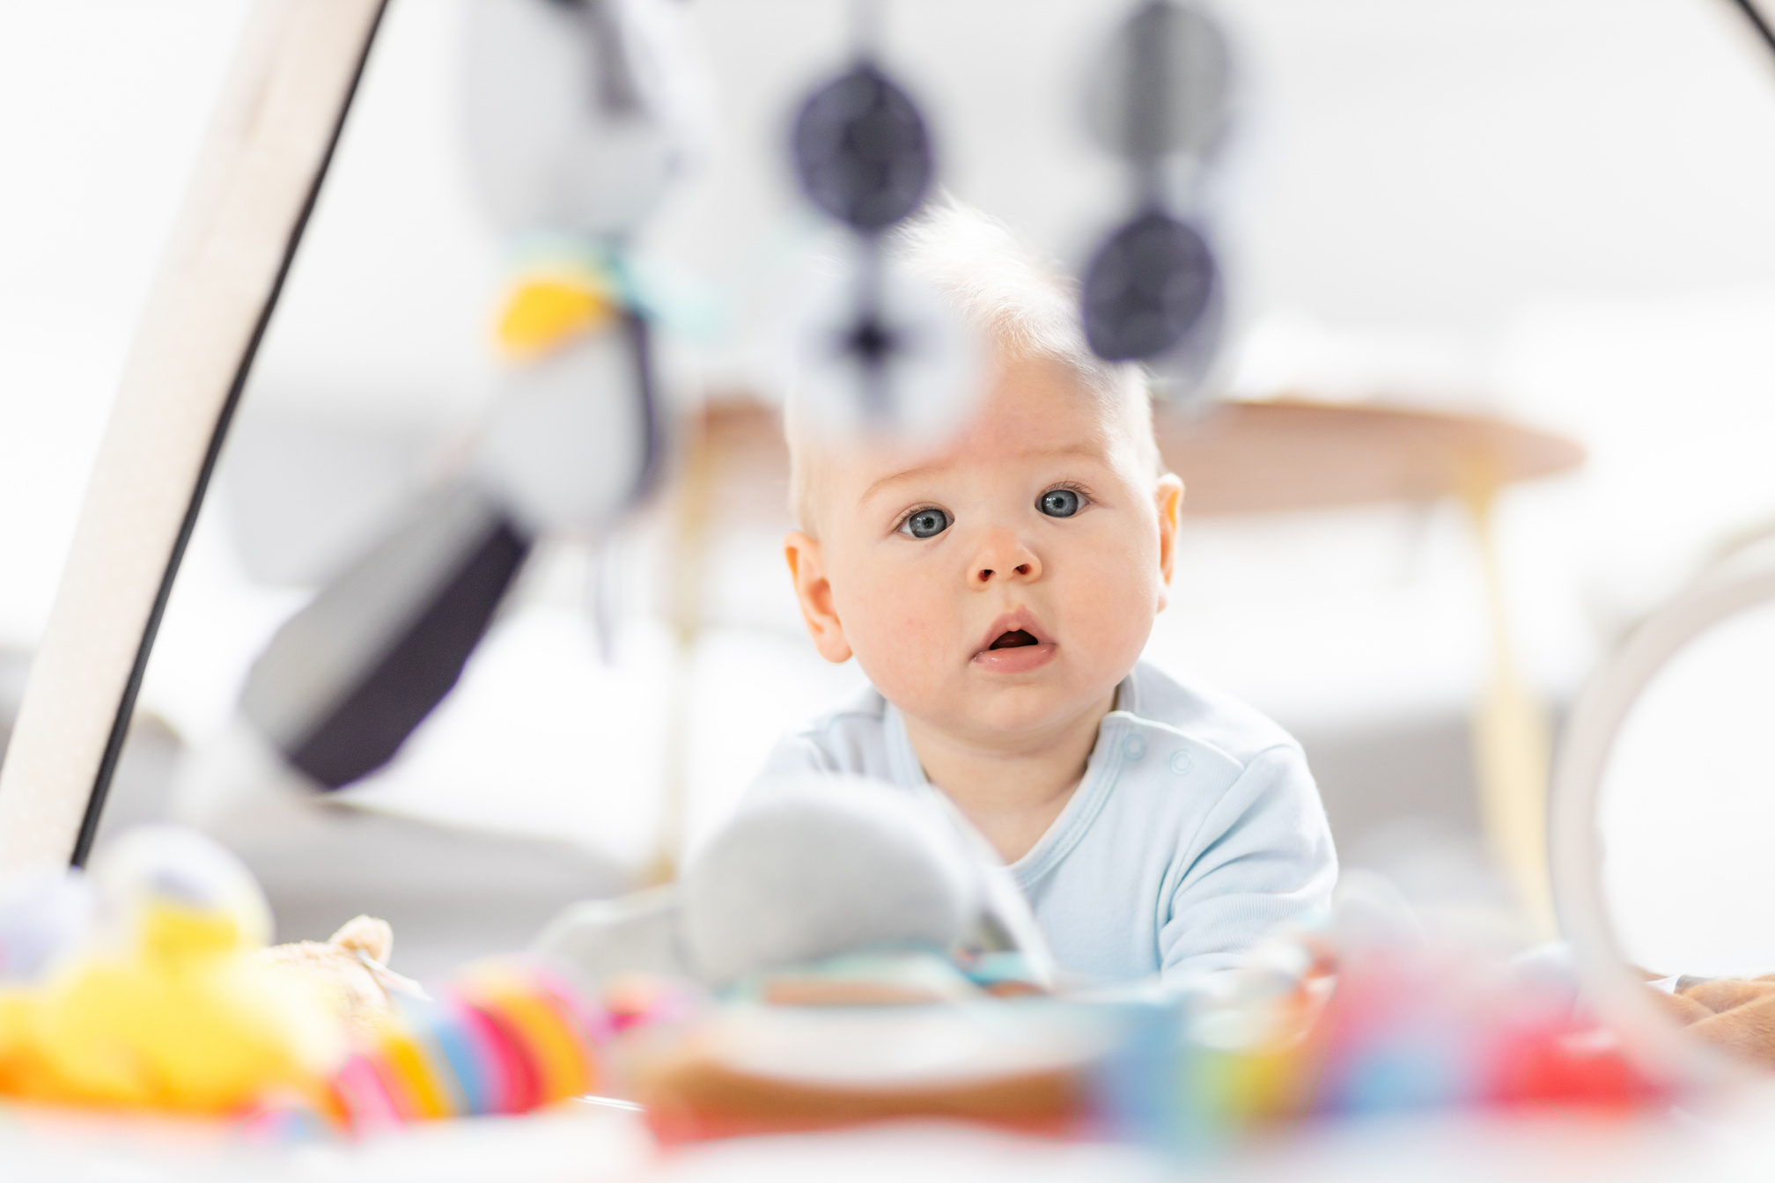



EARLY CHILDHOOD
Birth-Age 5
  Brain imaging studies have shown that the total volume of a baby’s brain increases by over 100% during the first year of life.
  Infants can use simple gestures, say mama or dada, follow simple directions.
  Meltdowns! Toddlers’ feelings include embarrassment, guilt, and shame and are learning to cope.
  Important to know how a healthy brain is built. “To know that loving adults are brain architects. To believe that what happens in the earliest years of life plants the success for a child’s future.”

Slide 7


MIDDLE CHILDHOOD
Ages 6-9
  Peer acceptance becomes more important during the school-age years
  With growing independence and desire for peer approval, this age often have a greater desire for space and privacy
  6 years: “Kids understand that there are rules and often rigidly expect other to fall in line - and they’re not shy about calling out anyone who doesn’t.” Growing Pains

Slide 8
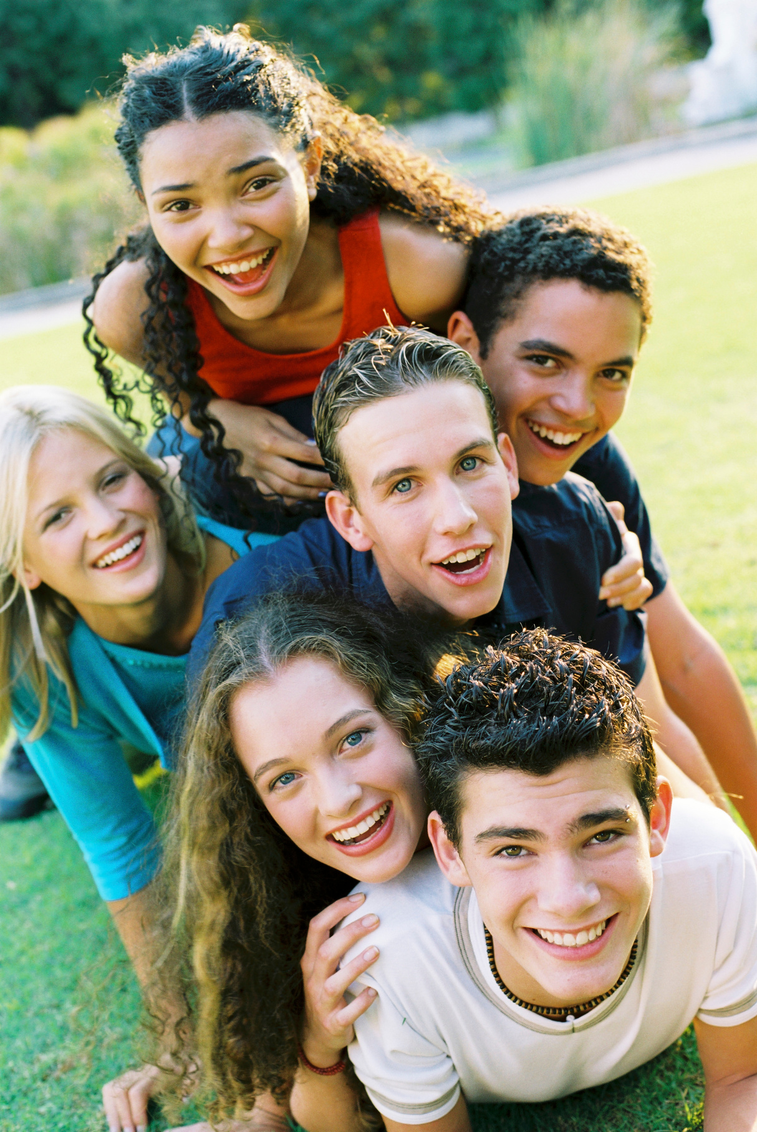
TWEEN/TEEN
Ages 10-18
  The onset of puberty makes tweens uncomfortable about their bodies. In our later teens, body image is still important to them.
  Brain development is happening at a rate similar to babies and toddlers. Teens need extra sleep and lots of snacks to keep up with their brain growth demands!
  Socially, teens highly value their friendships. When there is friction, teens feel like this is “the end of the world”.
  Tweens and teens are very interested in the world around them and are developing their own thoughts and opinions. Fairness and justice are very important to them.

Slide 9
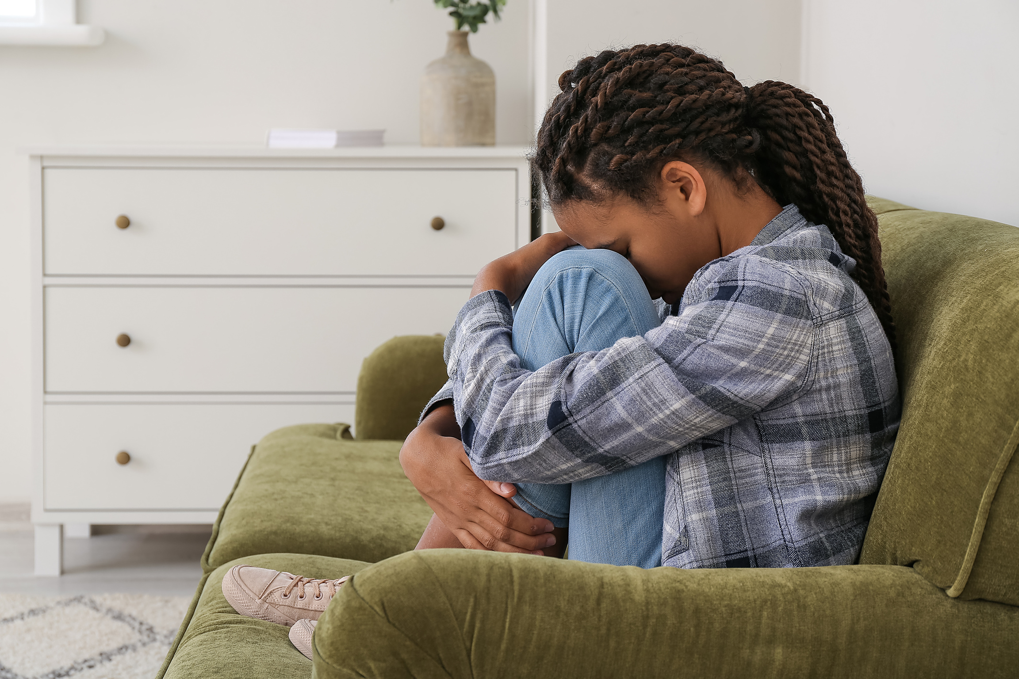
WHAT ARE ACES?
Adverse Childhood Experiences
Adverse Childhood Experiences (ACEs) are serious childhood traumas that can result in toxic stress, causing harm to a child’s brain. This toxic stress may make it difficult to learn, to play in a healthy way with other children, and can result in long-term health problems.
*Spokane Regional Health District, 2021
Notes:
ACEs are "adverse childhood experiences"
-Serious childhood traumas
-Can result in "toxic stress"
-Makes normal developmental activities (i.e. learning, playing) difficult
-Can result in long term health issues (talk about impact of stress hormones on brain development and the effect of heightened stress response over time on cardiovascular system)

Slide 10
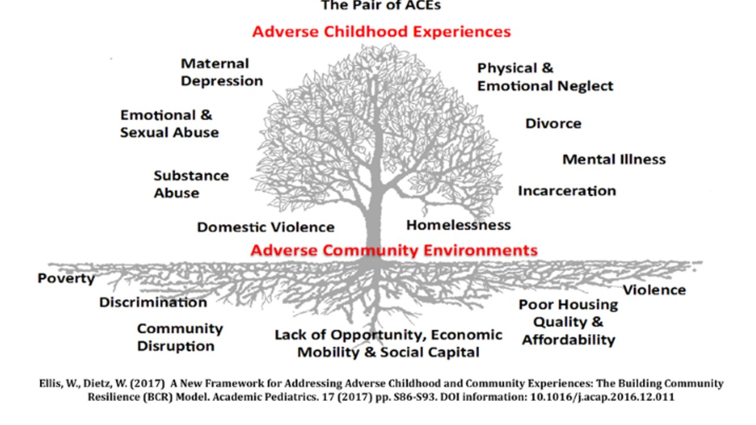
Notes:
"Pair of ACEs"
Adverse childhood experiences can be compounded by adverse community environments.
-Poverty, violence, discrimination, etc. can exacerbate/lead to ACEs such as substance abuse, domestic violence, incarceration
-These often go hand in hand, but not always- DON'T ASSUME!

Slide 11
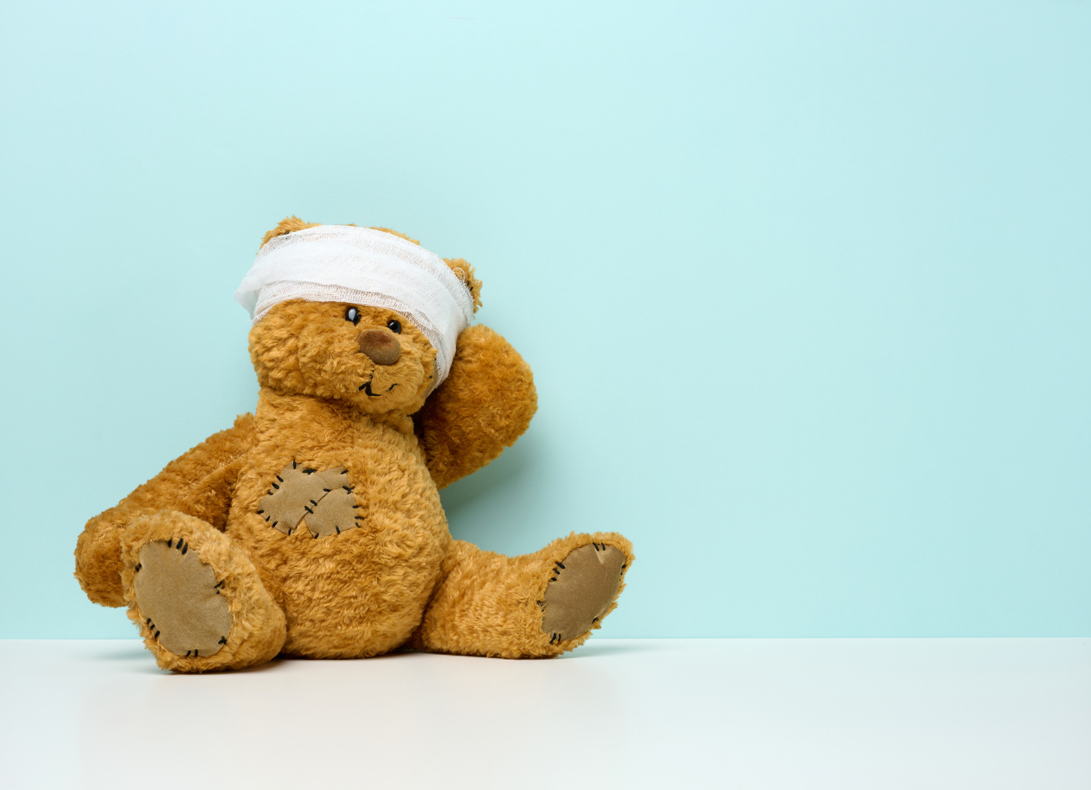
WHAT IS TRAUMA?
Definition (NASMHPD, 2006):
• The experience of violence and victimization including sexual abuse, physical abuse, severe neglect, loss, domestic violence and/or the witnessing of violence, terrorism or disasters.
DSM IV-TR (APA, 2000)
• Person’s response involves intense fear, horror and helplessness
• Extreme stress that overwhelms the person’s capacity to cope
Notes:
Most people experience some form of trauma. Trauma does not always present the same way because people learn different ways to handle the stress from trauma.
-Some develop resilience (we will touch on that shortly)
-Some develop unhealthy coping strategies (i.e. smoking, alcohol/drug abuse, intense social withdrawal)
-Differing fear responses (fight, flight, freeze, fawn)
-The more we experience fear responses, the more heightened and easily triggered those responses become.

Slide 12
UNDERSTANDING TRAUMA
Triggers
Self-Care
What are triggers?
Take care of yourself
External events/circumstances that predictably produce negative/disturbing reactions.
What are some triggers you are familiar with?
We often have our own traumatic histories and can experience vicarious trauma through our work.
What are some self-care tools you have used?
Notes:
Discussion slide:
First: What are triggers? Give definition, then ask "what are some triggers you are familiar with?"
Second: When we deal with patrons experiencing trauma-related issues, this can cause us to experience "vicarious trauma". Let us take a minute to talk about how we can take care of ourselves so we can better help our teen patrons.

Slide 13

BUILDING RESILIENCE
Support
Resources
What is resilience?
Resilience is the ability of a child to recover and show early and effective adaptation following a potentially traumatic event. (The National Child Traumatic Stress Network)
Some of the factors that affect resilience are listed on the right. The biggest factor is having a supportive, caring adult in their life.
Feeling safe
Caring adult
Notes:
Resilience is the key to being able to adapt and overcome trauma.
-How do people build resilience?
-Feeling safe and having a supportive, caring adult are two major factors in helping teens build resilience.

Slide 14





BUILDING BLOCKS OF RESILIENCE
Manage
Stress
Inner
Strength
Self
Confidence
Positive
Attitude
Seek Help
Solving
Problems
Resilience video:
https://www.albertafamilywellness.org/resources/video/brains-journey-to-resilience

Slide 15
APPLYING TRAUMA-INFORMED PRACTICES
Safety
Collaboration
Trustworthiness
Empowerment
Choice

Slide 16

HOW CAN THE LIBRARY HELP?
Let’s brainstorm ways that libraries can help build teen resilience!
What are you already doing that helps build resilience?
What can you do in the future to build teen resilience?
Collections
Programs
Services

Slide 17
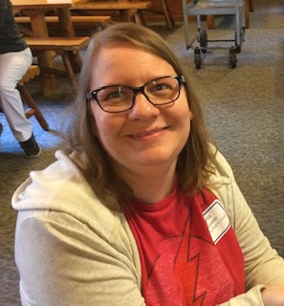
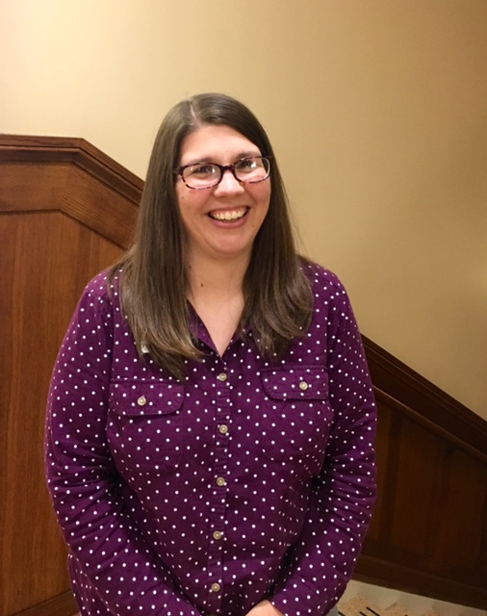
THANK YOU!
Nisa Kesseler
nkesseler@petoskeylibrary.org
231-758-3148
Megan Goedge
mgoedge@petoskeylibrary.org
231-758-3123

