Slide 1
The Community Closet
How to Expand the Social Safety Net at Your Library

Slide 2
What We’ll Cover
What is a community closet and what value will it add to your library
Community Partnerships: where to look and how to foster
Marketing approaches that consider the sensitive nature of this endeavor

Slide 3
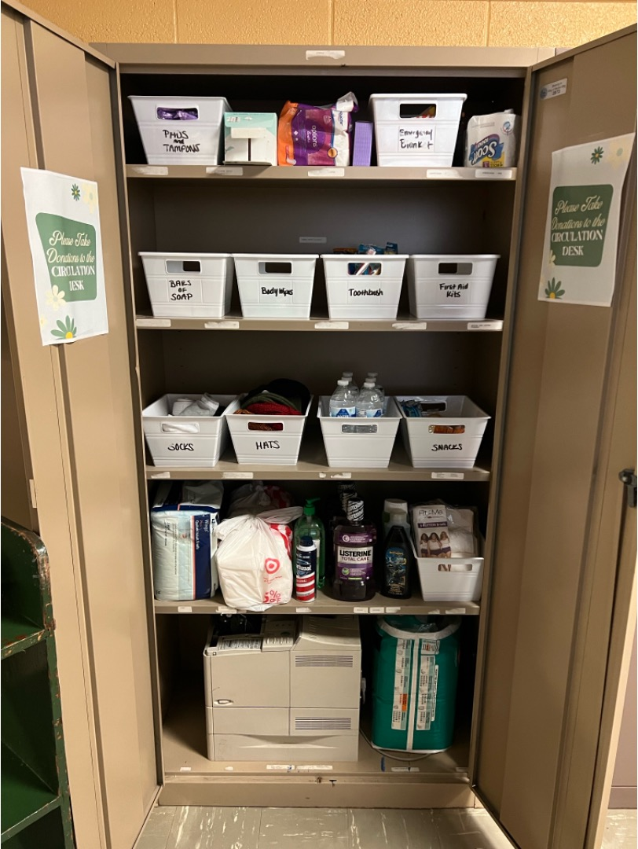
Origins
What is a Community Closet & How it Began at my Library

Slide 4
Things to Keep in Mind
Your community closet does not have to look like mine
  it doesn’t even have to be a “closet”
Use this framework to think about ways you can tailor this concept for your community
  What needs do your patrons already have?
  What community partners do you already have relationships with?

Slide 5
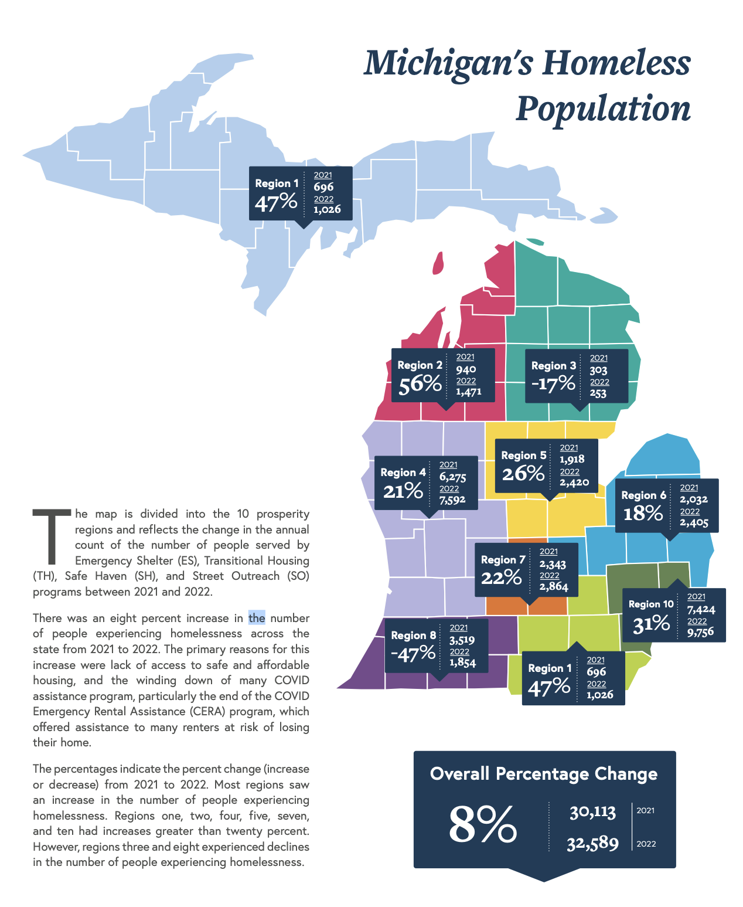
Why Start a Community Closet?
Erosion of federal social safety net programs
22% of people experiencing homelessness for the first time are children under 18 (2020, mihomeless.org)
Soap and toilet paper can be hard to obtain with SNAP and other assistance programs
2021-2022 via Michigan.gov
More details on mihomeless.org

Slide 6

Libraries are about Community

Slide 7
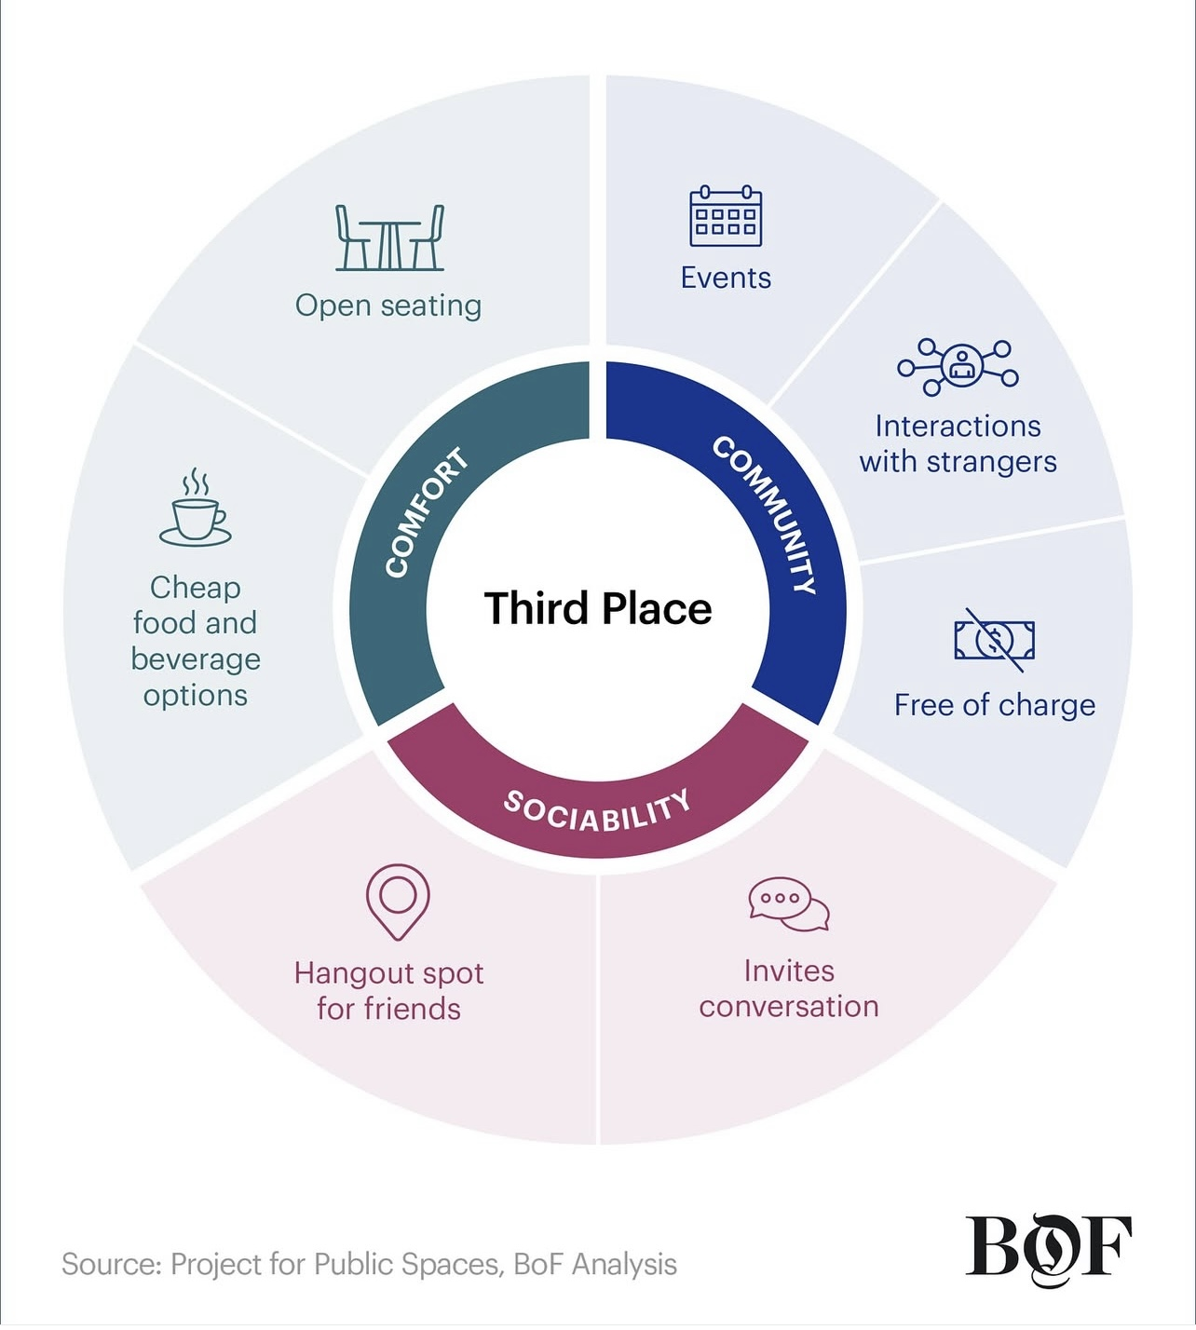
Why Start a Community Closet?
The Third Space – Ray Oldenburg
First Space: Home
Second Space: Workplace
Third Space: Anchors of Community Life
Why Third Spaces Matter
Combat loneliness
Climate resilience
Important for democracy & civic engagement

Slide 8
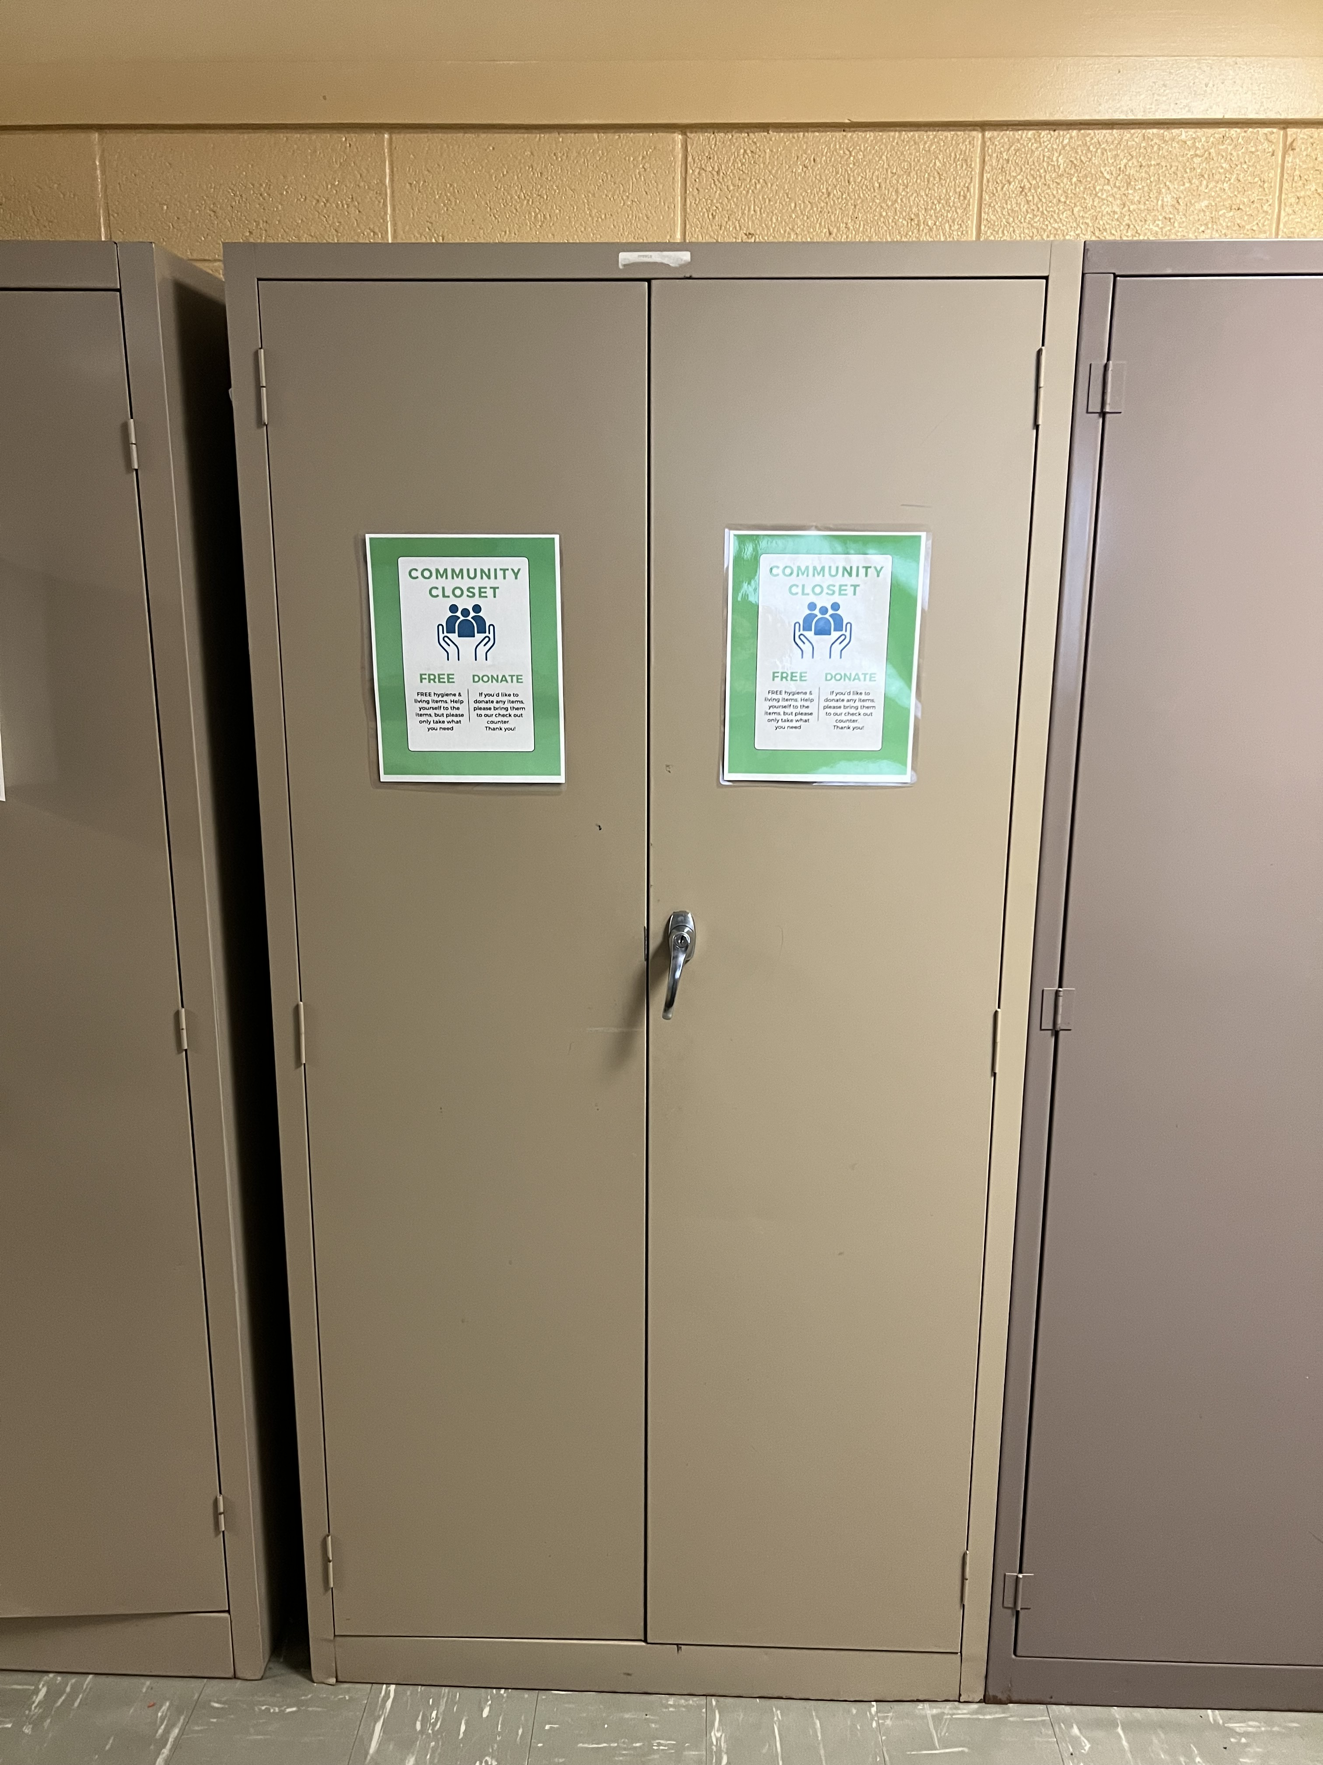


Slide 9
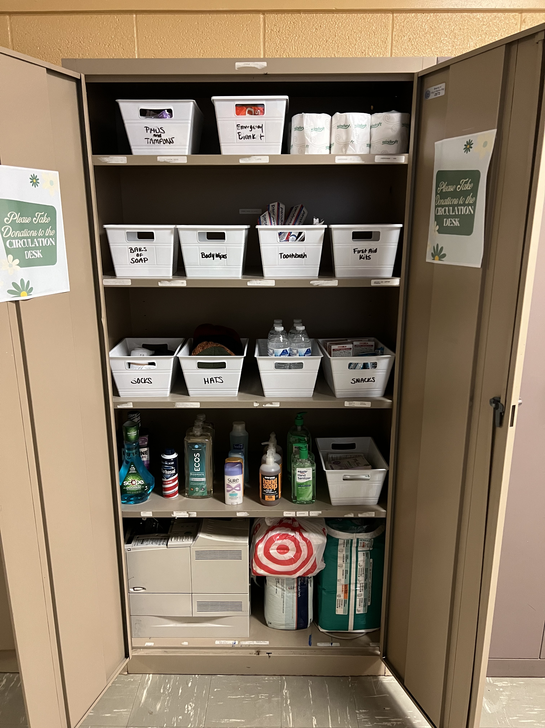

Slide 10
Supply List
Pads, Tampons, Adult disposable underwear
Hand Warmers & Emergency Blankets
Bars of Soap, Body Wipes, Toothbrush & Paste
First Aid Kits
Socks, Hats, Gloves, Scarves
Bottled Water
Snacks / Shelf Stable Food
Hand Sanitizer, Cleaning Products
Individually wrapped toilet paper

Slide 11
Is there anything you SHOULD NOT include in your closet?
Think about your specific community
For my closet, I opted to not include:
  any kind of razors/shaving items that included razors
  Items containing a high alcohol content, such as mouthwash
Build in systems to monitor the closet to keep unwanted items out

Slide 12
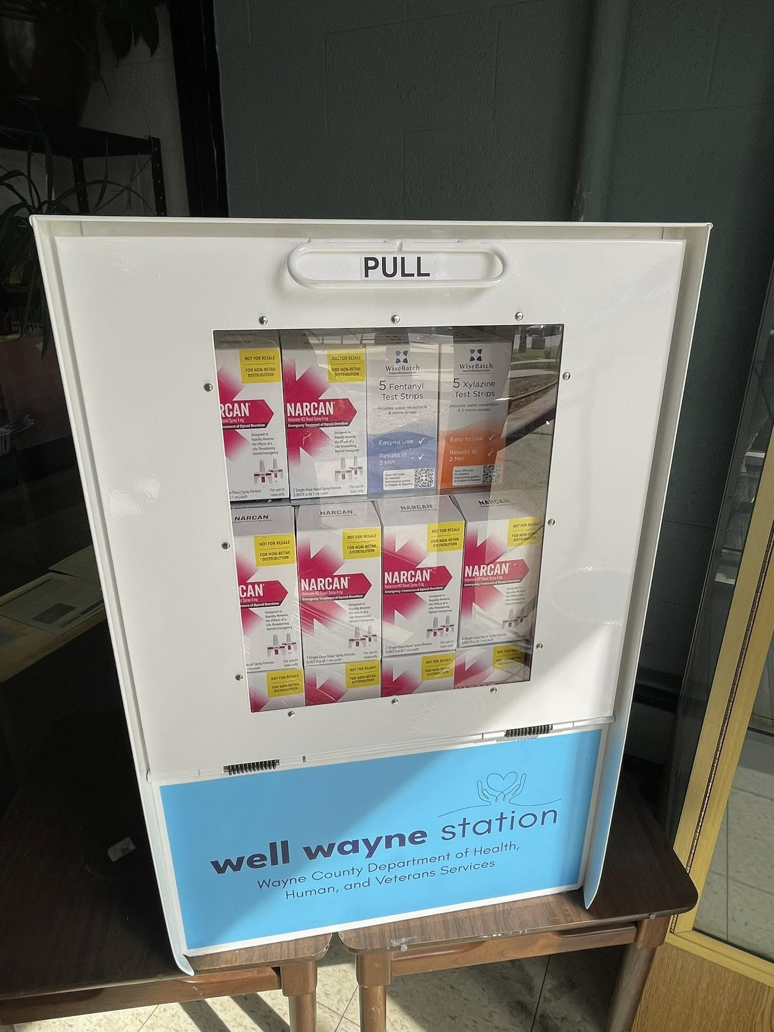
Sources for Supplies
Dollar Stores: Bins, Foods, First Aid Kits, etc.
Amazon: bulk items of hand warmers, socks, body wipes, etc.
Community Partners: Narcan dispenser
Donations: Knit hats, soaps, cleaning supplies

Slide 13
Ideas for Implementation
Community Cart
  Portable
Community Shelf or Cubby
  Use the space you have
Community Basket
  Some libraries already have this in their rest rooms
Discreet areas work best

Slide 14
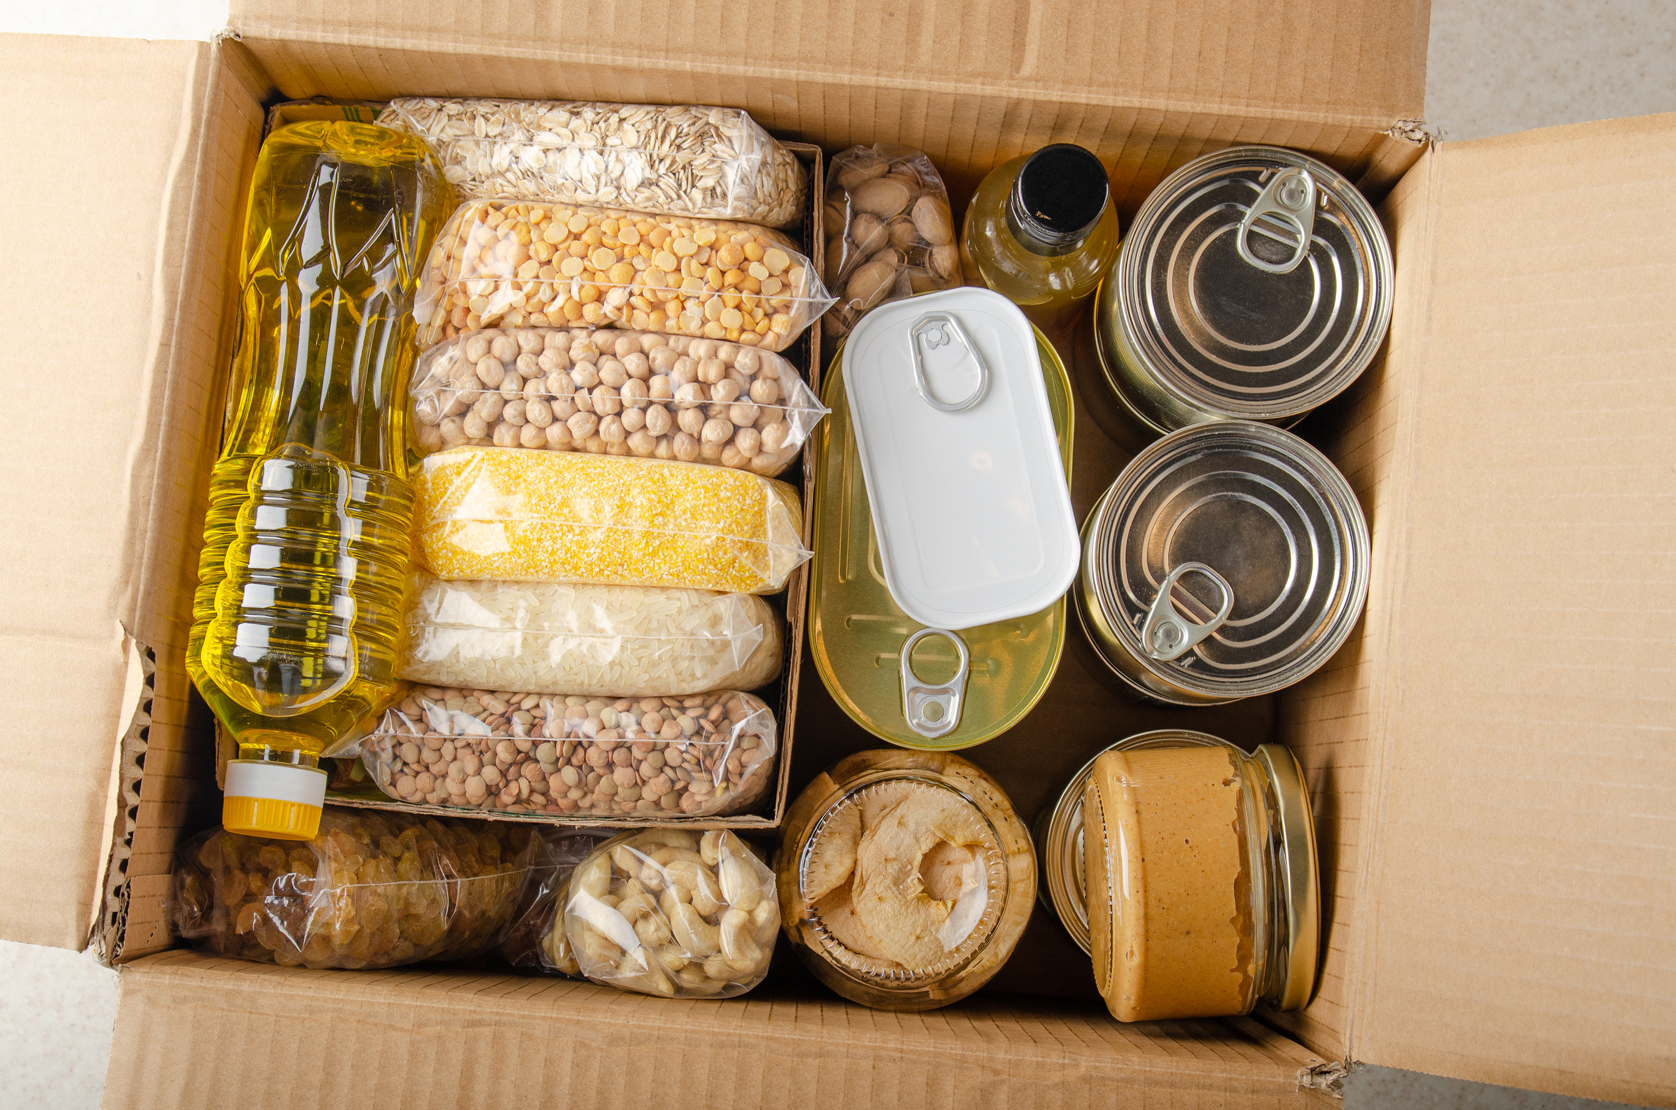
Managing and Sustaining Your Closet
Limit the quantity of items
Rotate seasonally
Create a backstock
Keep your feelers out

Slide 15
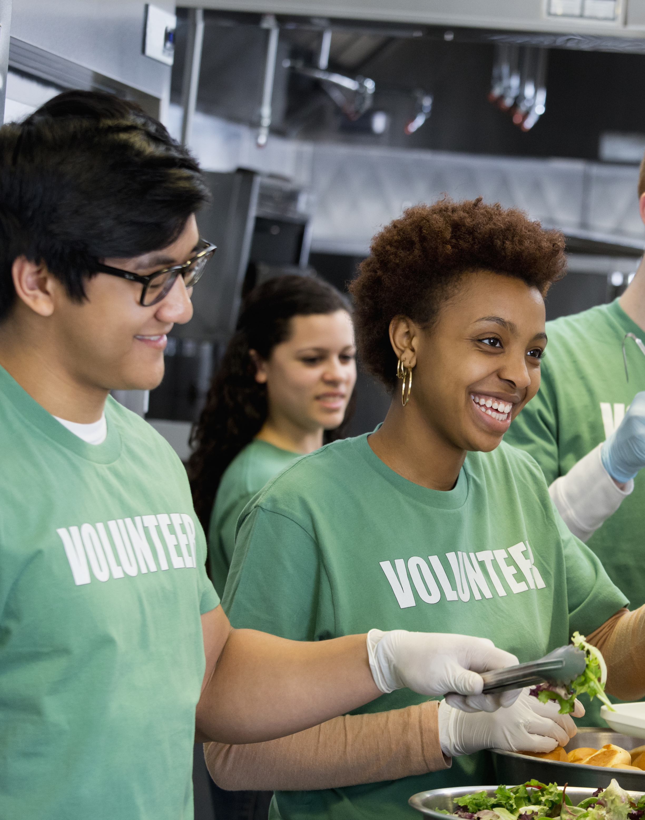
Community Partnerships

Slide 16
Where to Find Partners
State Level: Labor & Economic Opportunity
County Level
  Are there current initiatives you can apply for? i.e. Wayne County Well Wayne Station
  Grants or other funding support
Other Non-profits
  Friends Group
  Targeted groups to help with specific supplies (I Support the Girls)
  Satellite outpost for food pantry
Businesses
  Donate supplies in exchange for advertising, i.e. brought to you by, sponsored by, etc.

Slide 17

Business Partnership Tips
More than just summer reading support
Year-round visibility
Look for businesses that already have a charitable presence or are a “fixture” in your community
Also look for businesses that fit or share the same mission

Slide 18

Community Support
Ask for donations
Be clear about what you accept/need/want
Amazon wish lists
Use the talents of your community, i.e. knit items
This can be a way to create sustainability

Slide 19
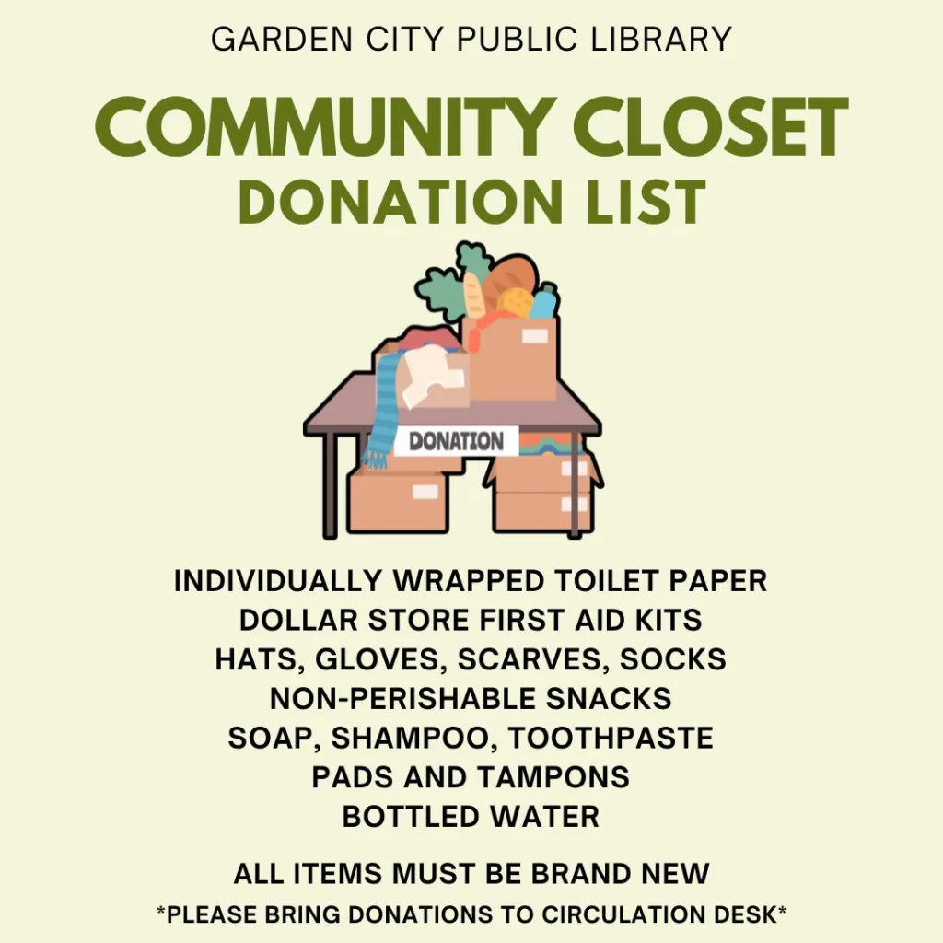

Slide 20
Community Partner Ideas
Mobile showers and mobile laundry services
  WAVE project SE MI
  Meltrotter.org Grand Rapids Area
Meal Services
  Gather to Grow / Feeding America West Michigan
  Meet Up and Eat Up

Slide 21
Thoughtful Marketing

Slide 22
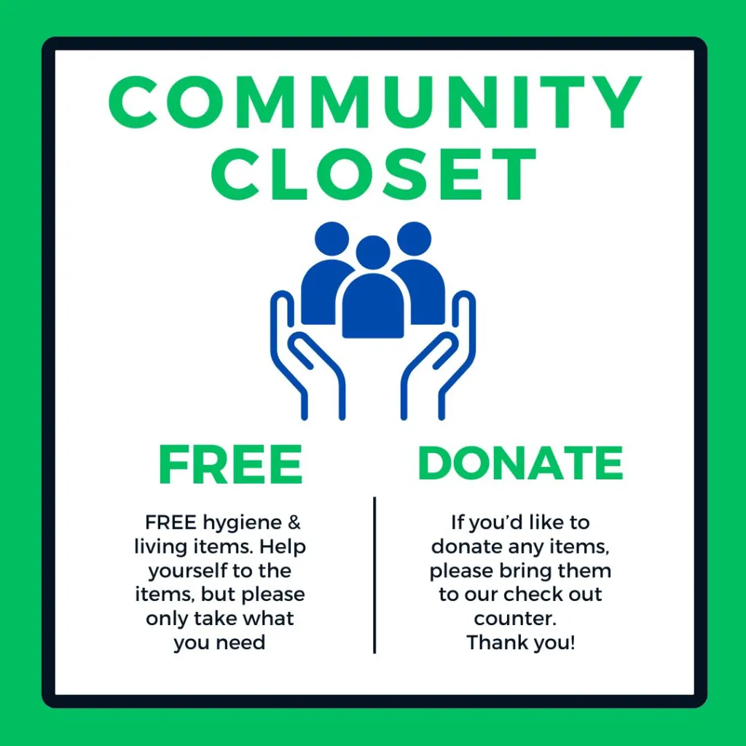

Slide 23
Advertising the Closet
In-House Marketing: Posters in bathrooms, clear location signage, flyers for donation list
Verbiage: Highlight the no cost aspect, but remind gently to only take what you need
Outsourcing: Smaller paper flyers & posters can be spread around town
Social Media: lucky day style posts, photos/video attract more attention
Website: consider creating a tab or page to detail how the closet works and what patrons can expect

Slide 24
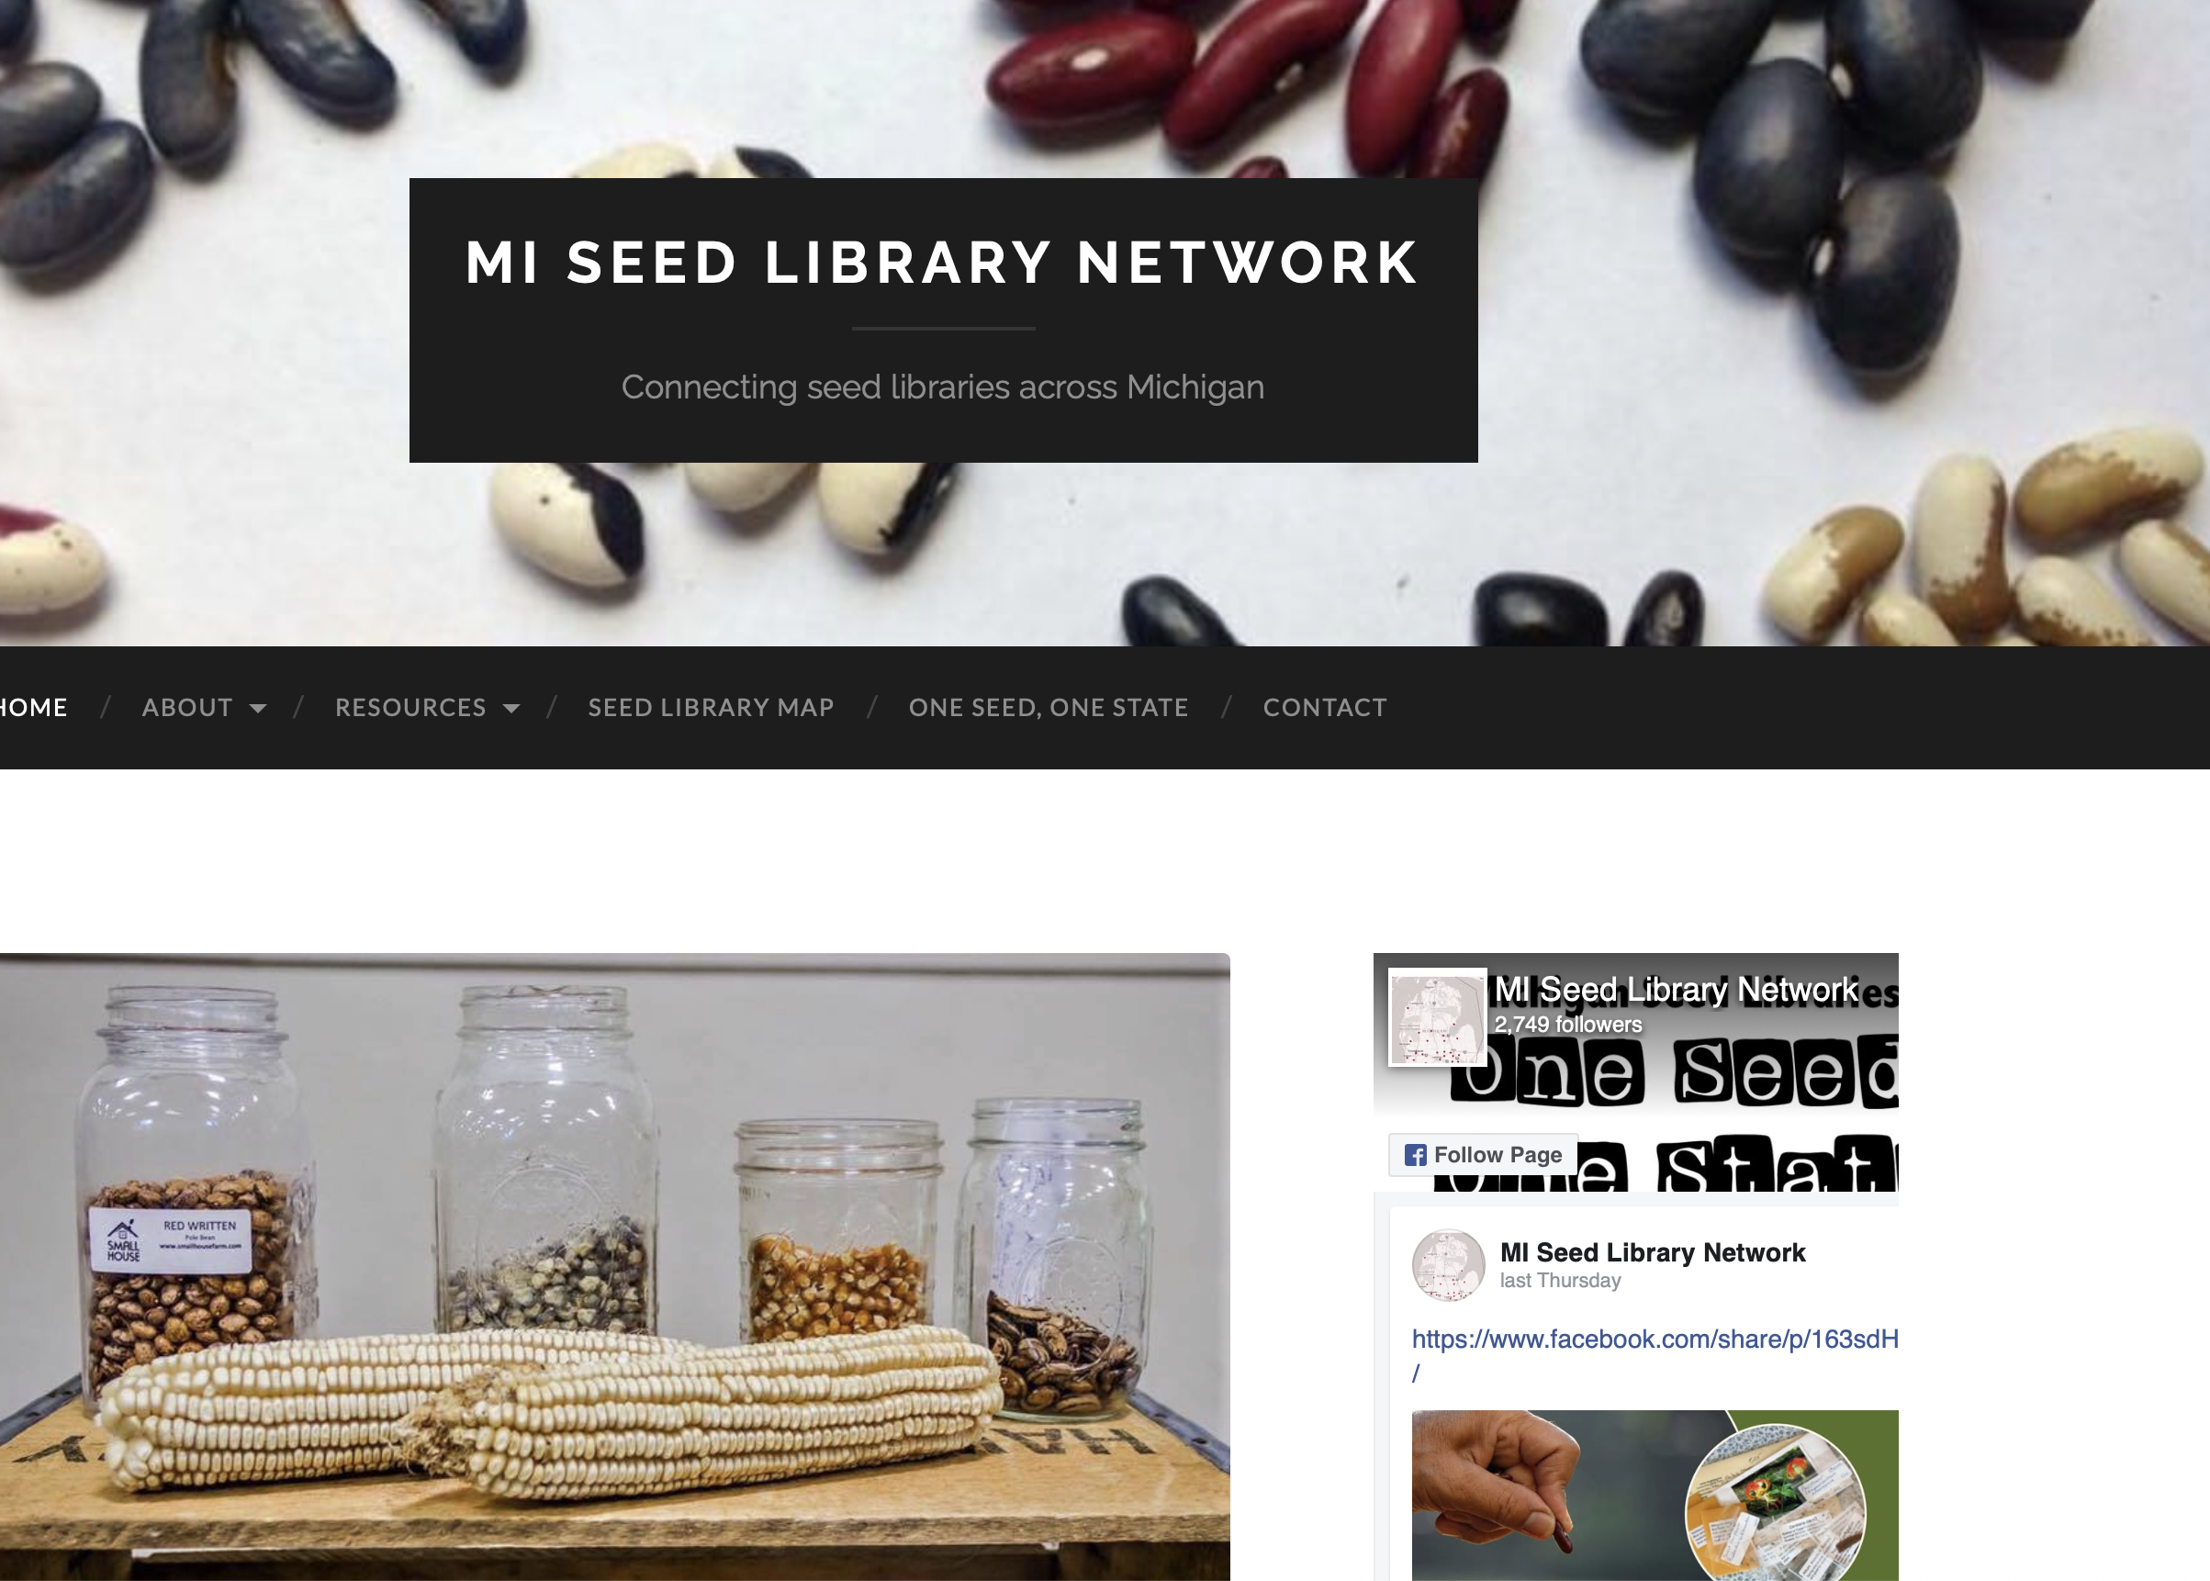
The Future of the Community Closet
A website that has a map of all the community closets and what they usually have stocked

Slide 25
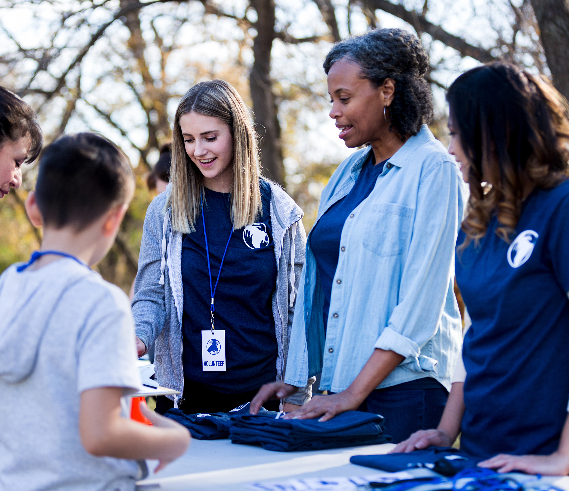
Takeaways
You probably already have patrons in need coming into your building
This deepens our connections to our communities and fosters a greater sense of goodwill – we are a place people can depend on
It doesn’t have to cost a lot of time & money; it can be as simple as creating a dedicated space that patrons facilitate themselves

Slide 26
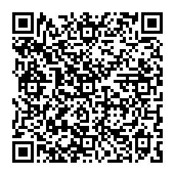
Get a Copy of this Presentation
Let’s Connect!
eschwartz@oakparkmi.gov

