Slide 1
A Vinyl Collection @ Your Library: A Sound Idea
Presented by: Emily Crosby, Royal Oak Public Library
Terri Frank, Brighton District Library
Notes:
Terri

Slide 2
Background/Statistics
Notes:
Terri

Slide 3
The Case for Vinyl
“Vinyl overtakes CD sales for the first time since 1987.”
-The Verge, 3-10-2023
“Vinyl records sales continue to grow for the 17th year running.”
-RIAA Annual Report, 2023
“The week ending December 22, 2022 was the largest sales week for vinyl since 1991.”
-Billboard, 12-29-2022
Notes:
Terri

Slide 4
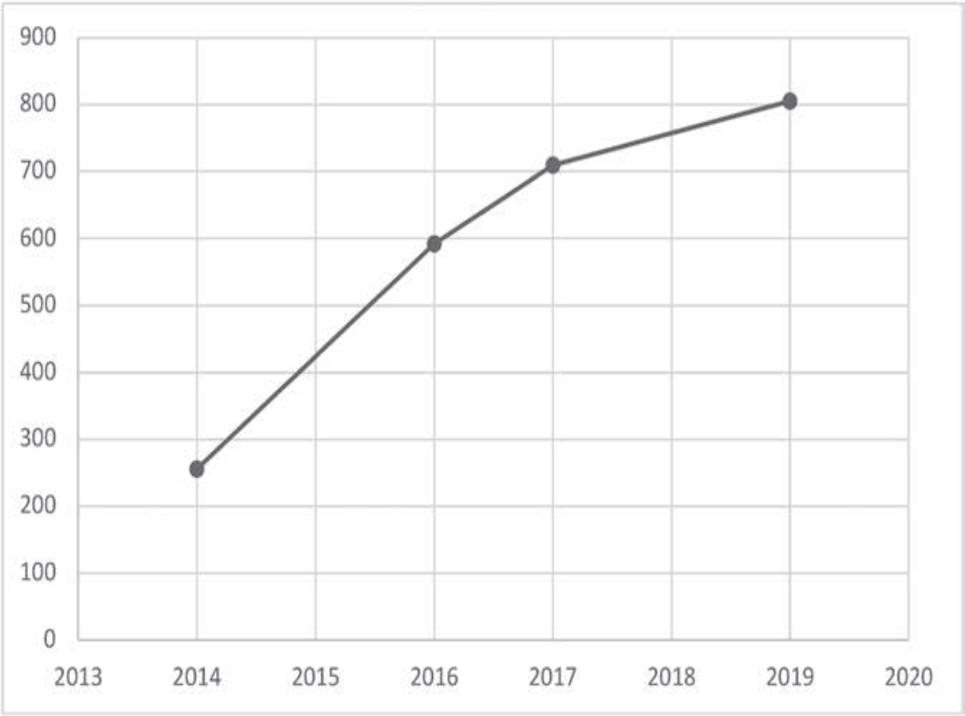

Circulation of LPs: 2014-2019
University of Colorado-Boulder Library
Source: Bonjack, Stephanie. “The Audacity of Hi-Fi: A Case for Lending LP Recordings,” Notes, vol. 79, March 2023.
Notes:
Terri

Slide 5


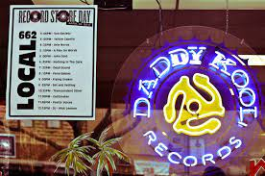
Factors Driving the Resurgence
Artists
Generations
Record Store Day
Exclusive Vinyl only releases
Taylor Swift, Harry Styles, Adele
Disputes with Streaming Companies
Audiophiles-better sound quality
Nostalgia (Boomers, Gen X)
Gen Z likes the artwork, tangible feel to records
April 22 nationwide, heavily promoted on Social media
Galaxy Records (Howell) opened in January 2023
Notes:
Terri

Slide 6
Why Did We Each Start a Vinyl Collection?
Notes:
Emily

Slide 7
Emily – Royal Oak Public Library
Remembered listening to vinyl as a kid at my grandparents house.
Rediscovered my personal vinyl collection in 2020, became obsessed.
Started researching vinyl, and contacted Kent District Library, and Ann Arbor District Library about their circulating collections.
Began collection in November of 2021. Four years later, and we’ve got 664 albums and four bins!
Notes:
Emily

Slide 8
Terri – Brighton District Library
Assigned Music CD collection and began researching thoroughly!
Gen X – I remember libraries circulating vinyl and my “silent generation” parents owning records
My Gen Z Kids – Asking to go to record stores!
Came across a catalog record for a Vinyl LP in shared catalog system. Contacted Emily.
Notes:
Terri

Slide 9
Beginning Budgets
Notes:
Emily

Slide 10
Beginning Budgets
Royal Oak
Brighton
2021-2022
  $2500 ($1000 to start, Friends supplied extra $1500)
2022-2023
  $4000
2023-2024
  $5000
2024-2025
  $5000
2025-2026
  $7000
2023-2024
  $1200 to start + $440 for supplies
  $1200 ongoing
2024-2025
  $3200 (CD’s & Vinyl)
2025-2026
  $3200 (CD’s & Vinyl)
Notes:
Emily - RO Terri - BDL

Slide 11
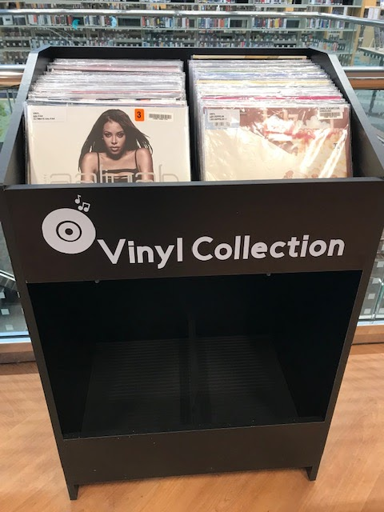
# 1: SHELVING UNIT
LP Bin: $329.99 (holds 450 LP’s)
Groove Mats & Center Dividers Kit: $43.99
Shipping: Free (if picked up)
Vendor: lpbin.com (Warren, MI)
Vinyl Stick-On Lettering: $17.98 (free - Cricut)
Dimensions: 22” deep x 28.5” wide x 44.5” high
Notes:
Terri

Slide 12
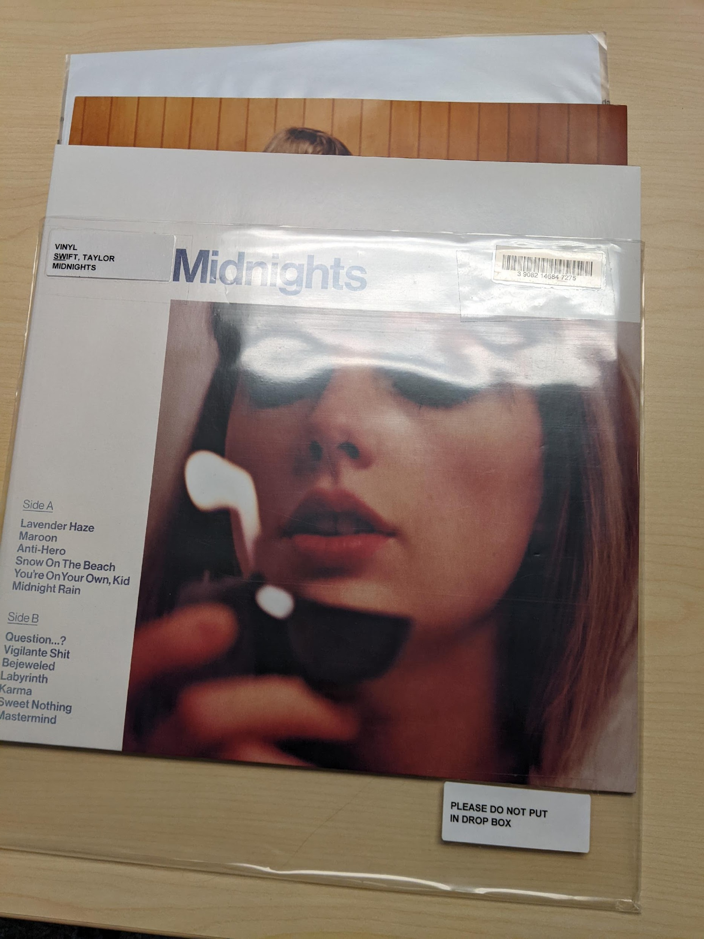
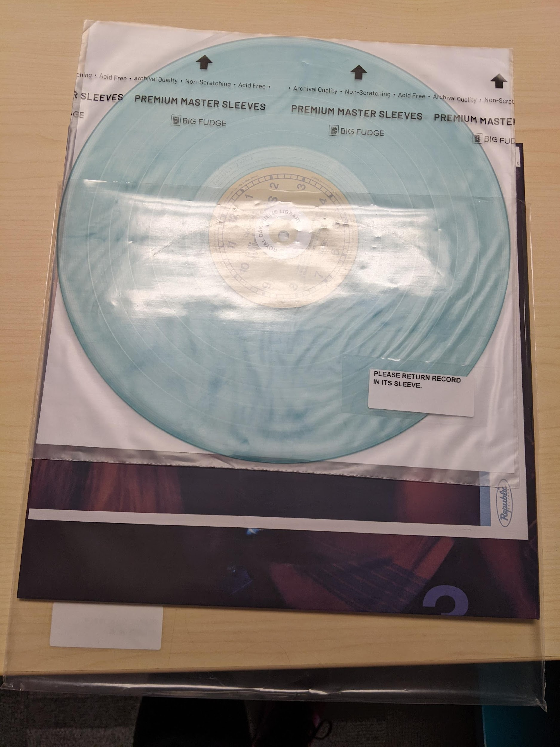
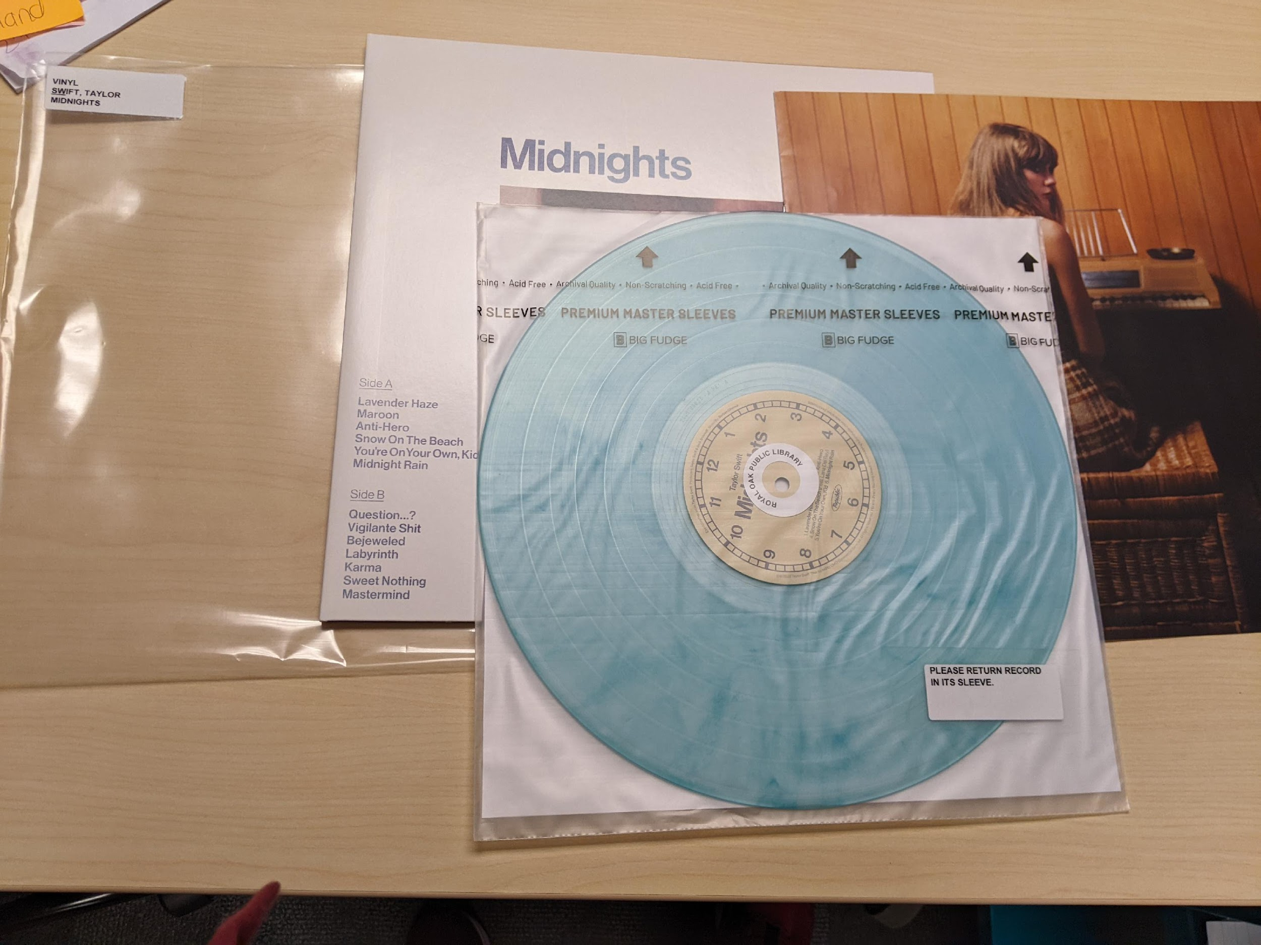
#2: OUTER & INNER PROTECTIVE SLEEVES
$38.89 for a combo pack of 50 (2)
https://tinyurl.com/mubwksdw
Sleevie Wonder XL Box Set Sleeves
$14.99 for 5 -Used for large albums
https://tinyurl.com/4cd74jsn
Outer Sleeve (RO)
Inner Sleeve (RO)
Notes:
Terri
Sleevie Wonder vinyl sleeves have multiple sizes for box sets as well.

Slide 13
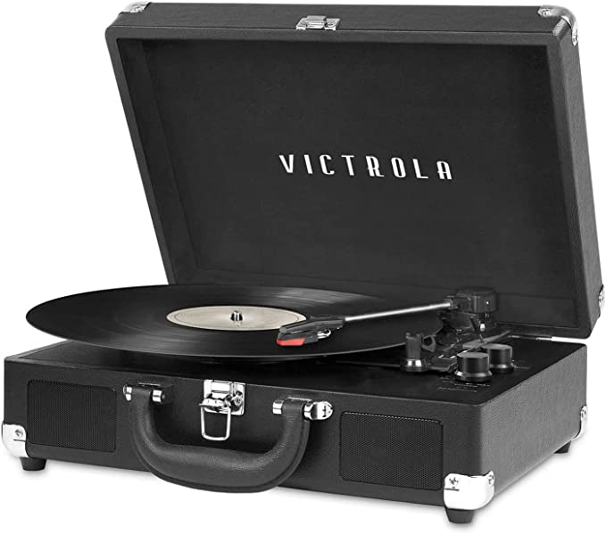
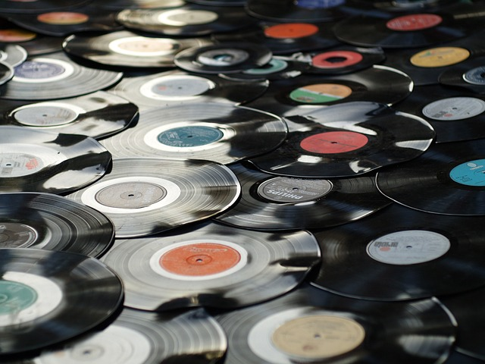
…and #3…RECORDS!!!
Area Libraries recommended starting out with $1,200
This allows for an initial purchase of roughly 45 albums or 4 records/month
It was also suggested we purchase 1-2 more portable record players. Purchased 2 @ 54.99 each from the Library of Things budget.
Notes:
Terri

Slide 14
Selection Criteria &Vendors
Notes:
Terri

Slide 15
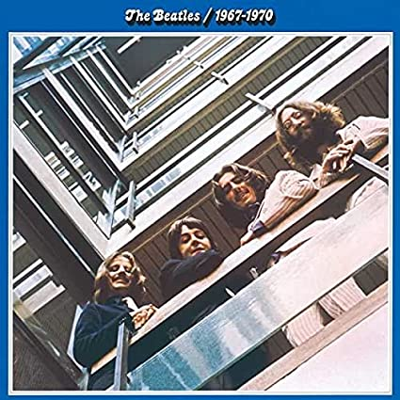
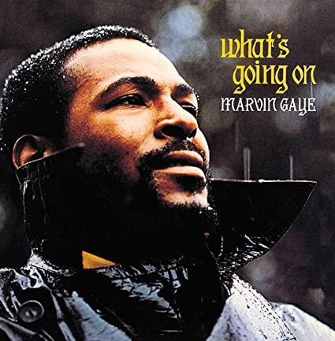
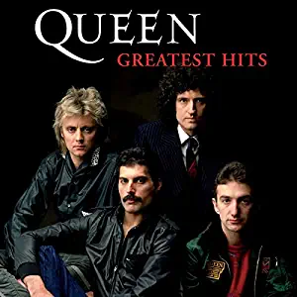
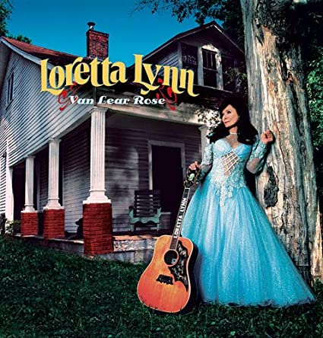
Selecting Your
Initial collection
Other libraries’ lists of their top circulating albums
Core lists such as Rolling Stone’s 500 Greatest Albums of All Time
Music review sources including AllMusic, Billboard, Variety, EW
Staff and patron suggestions. NO DONATIONS
Recommended vendors: Alliance, Amazon, Target
Notes:
Terri

Slide 16
Suggested Allocation
Rolling Stone Top 500 – 25%
Billboard Top 200 – 25%
Local Artist or Interest – 25% (Motown, Bob Seger, etc.)
Genre other than Rock-25% (Classical, Soundtracks, etc.)
Notes:
Terri

Slide 17
Cataloging and Processing
Notes:
Emily

Slide 18
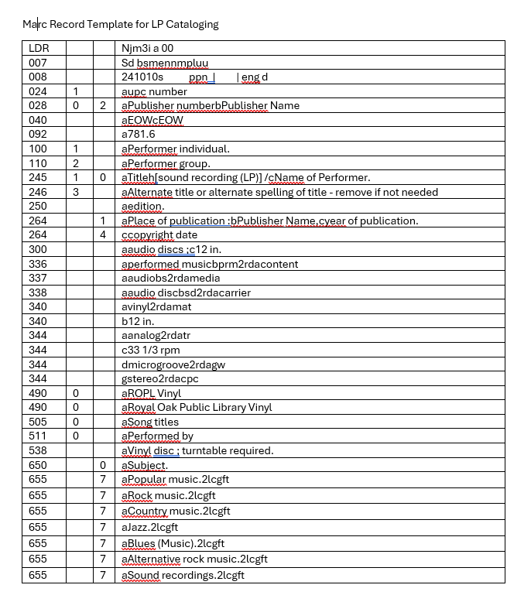
Cataloging
TLN provides us with a basic
template.
Notes:
Emily

Slide 19
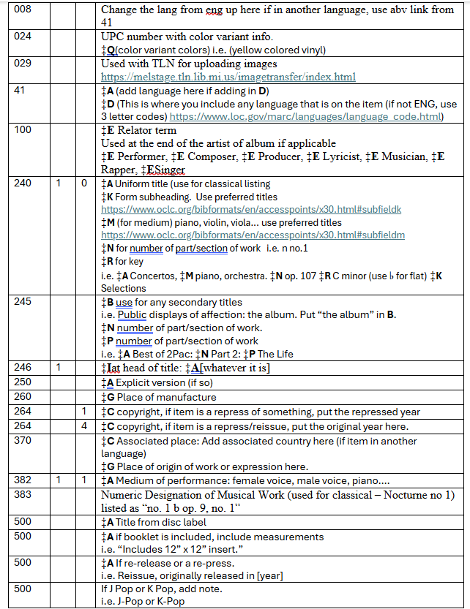
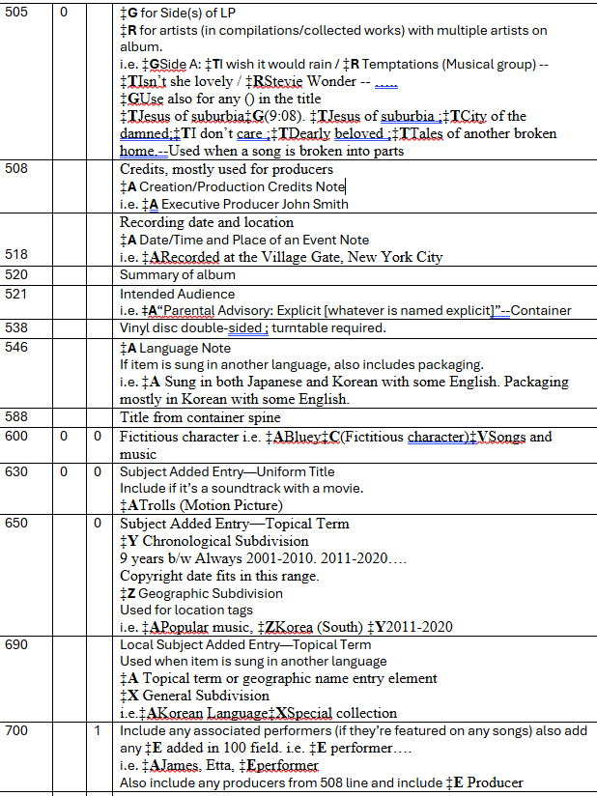
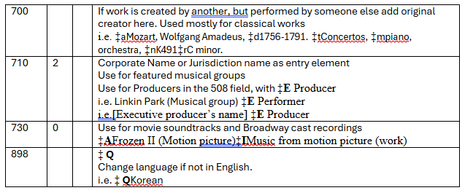
Cataloging Cheat Sheet
Notes:
Emily

Slide 20
Cataloging Sites
Skyriver
OCLC’s Bibliographic Formats and Standards
https://www.oclc.org/bibformats/en/home.html
WorldCat
https://search.worldcat.org/
Rock and Roll Hall of Fame Library
https://rockhall.on.worldcat.org/discovery
Notes:
Emily

Slide 21
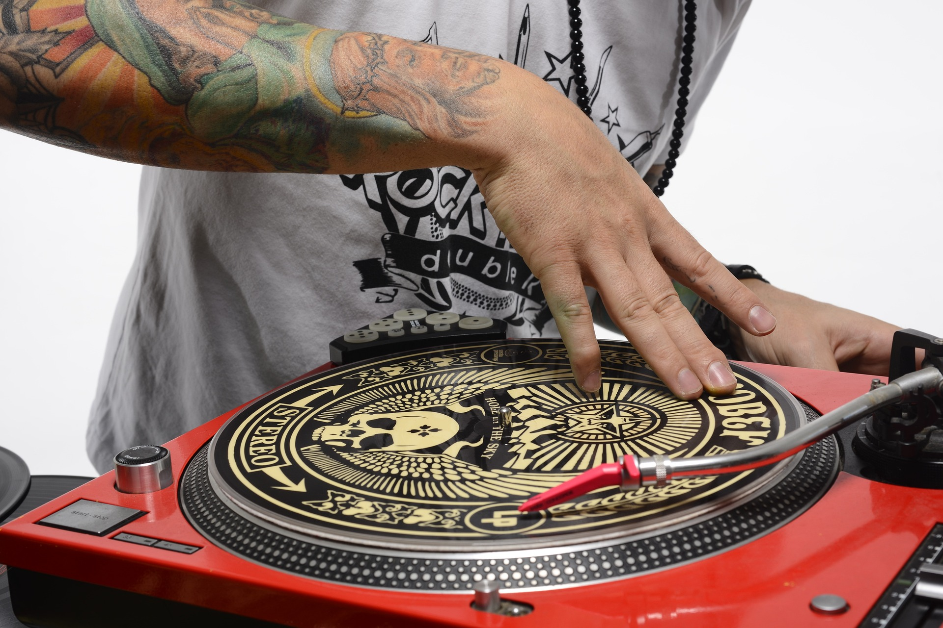
Protecting & Discarding Vinyl
“We haven't had any issues with scratched vinyl! Vinyl tends to scratch when it's going in and out of the album's cardboard and the paper sleeves they come in. We use outer sleeves for the entire album (artwork, and LPs) and inner sleeves for each LP.”
“We discard the vinyl and recycle the covers.”
“Don’t accept donations for this collection. We found these were often scratched and took up a ton of staff time. Buy only new records. Direct donations to the Friends of the Library. ”
Notes:
Emily

Slide 22
What Worked? What Didn’t?
Notes:
Emily

Slide 23
Brighton
What Worked?
What Didn’t?
-Volunteers
-Listening to “scratches”
-Neon light
-More promotion
-Dividers needed
-Restrictive limit
Notes:
Terri

Slide 24
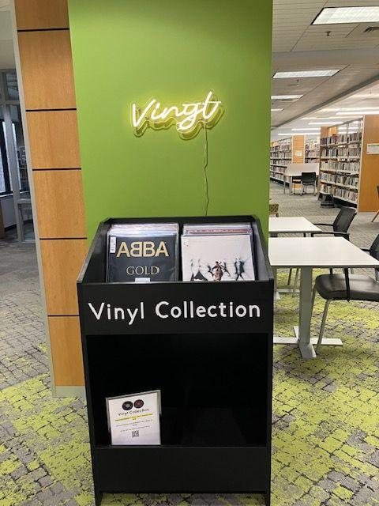
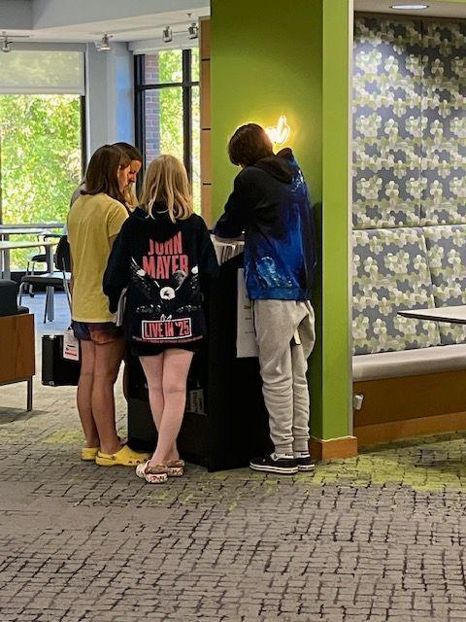

Slide 25
Royal Oak
What Worked?
What Didn’t?
Using polypropylene inner and outer sleeves, hardly any scratches.
Cabinets from LP bin, with groove mats and divider bar.
Suggestion box, including online form.
Asking Circulation department about packaging and arrangement.
Original outer sleeves tear, looking into larger ones.
Putting stickers and processing on outer sleeve, more time consuming to replace.
Notes:
Emily

Slide 26
The Top Albums
Take a second and work with a partner/group and decide the first 10 albums you would want in your collection.
Notes:
Emily

Slide 27
Royal Oak’s Top 10 Circulating Albums
This Year
Overall
Intimate Chopin
Kind of Blue–Miles Davis
Rise and Fall of a Midwest Princess–Chappell Roan
Motown’s Greatest Hits
Greatest Hits–Queen
Bluey Dance Mode!--Bluey
Guardians of the Galaxy V.2
Short n’ Sweet–Sabrina Carpenter
I’ve Tried Everything but Therapy pt 1–Teddy Swims
Donuts–J. Dilla
Kind of Blue–Miles Davis
Giant Steps–John Coltrane
1–The Beatles
Ella Fitzgerald & Louis Armstrong
Duke Ellington & John Coltrane
Hits–John Coltrane
Greatest Hits II—Queen
Abbey Road–The Beatles
Back to Black–Amy Winehouse
Happier than Ever—Billie Eilish
Notes:
Emily

Slide 28
Brighton’s Top Circulating Albums
ABBA Gold Greatest Hits - ABBA
Hozier - Hozier
Six Evolutions: Bach Cellos Suites - Yo-Yo Ma
Motown Greatest Hits - Various
Midnights - Taylor Swift
Greatest Hits - Queen
Rumours - Fleetwood Mac
Tortured Poets Department - Taylor Swift
Ultimate Sinatra - Frank Sinatra
Nevermind - Nirvana
Notes:
Terri

Slide 29
Last Words of Advice from Other Libraries
“It’s a trial and error process. Listeners of cd’s check out different artists than that of vinyl.”
“It can be tough to get some albums because of the demand, and also some things are limited presses.”
“Your patrons and staff are going to have so much fun with this collection!”
Notes:
Emily

Slide 30
WORKS CITED
Bonjack, Stephanie. “The Audacity of Hi-Fi: A Case for Lending LP Recordings,” Notes, vol. 79, March 2023.
CBS New York. “Vinyl Makes Comeback at Brooklyn Public Library.” August 9, 2022. https://tinyurl.com/3n4uax2v
Christman, Ed. “Record Store Day 2023: Taylor Swift’s ‘Folklore’ Release Brings Long Lines, Sellouts at Retailers.” Billboard, April 27, 2023.
Frank, Terri. Google Forms Survey to Vinyl-holding Michigan Libraries, 2023.
Recording Industry Association of America. RIAA Annual Report 2022. riaa.com/reports
Sax, David. The Revenge of Analog. New York: Public Affairs, 2016.
Weatherbed, Jess. “Vinyl Overtakes CD Sales for the First Time Since 1987.” The Verge, March 10, 2023.
Notes:
Emily

Slide 31
Questions? Contact Us!
Emily Crosby – Emily.Crosby@romi.gov
Terri Frank – terri@brightonlibrary.info
Notes:
Emily

